Slide 1
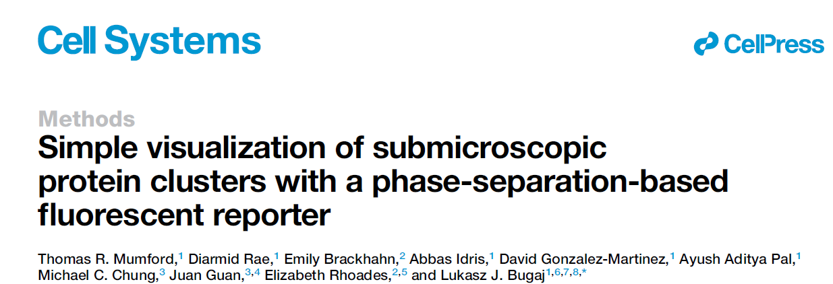
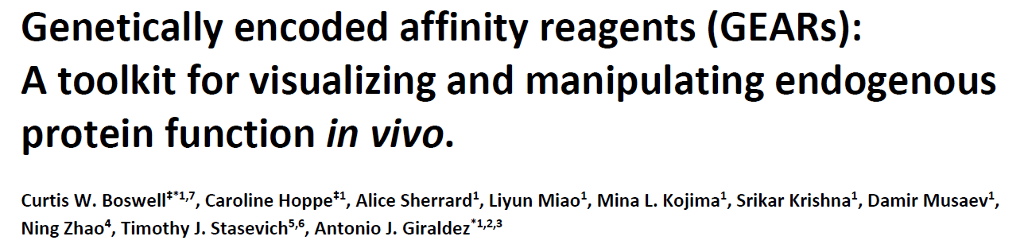
CluMPS and GEARs:
Nanobodies-based techniques for endogenous proteins visualization and manipulation
TJC 20.02.24 - Magio

Slide 2
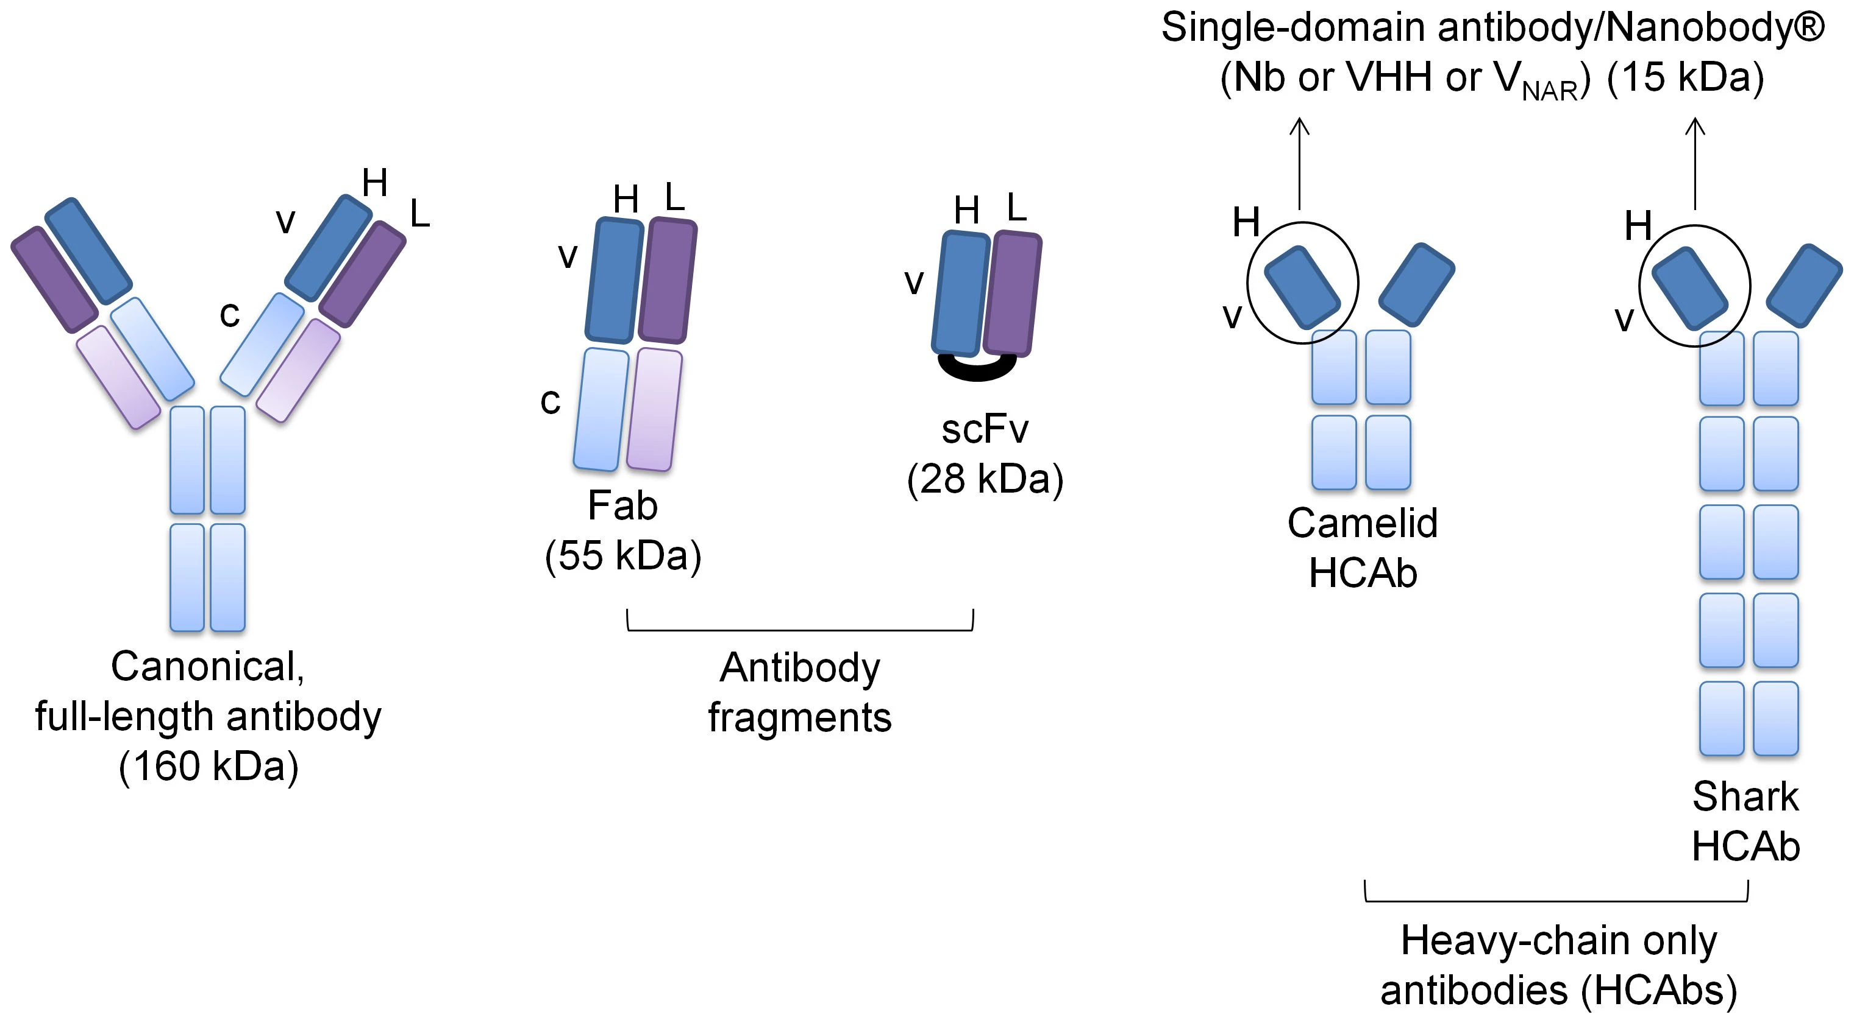
Nanobodies: immunological oddities

Slide 3
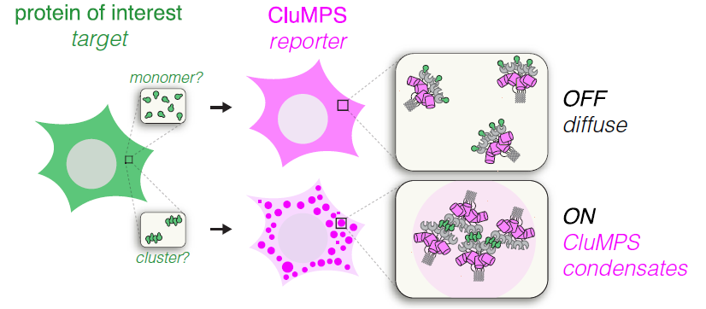
Lack of straightforward tools for visualizing small clusters of physiologically relevant proteins :
Conventional fluorescence microscopy is not sensitive enough for small aggregates -> Fluorescent protein tagging does not solve the issue
Overexpression of the target introduces clustering artifact
Specialized microscopy techniques (FRET, super-res.) are complex, slow, and require specialized equipment

Slide 4
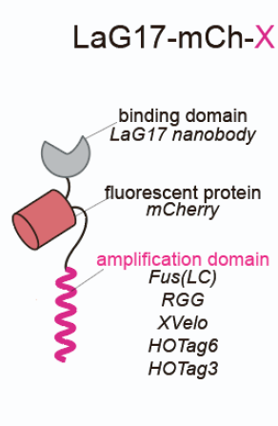
Lack of straightforward tools for visualizing small clusters of physiologically relevant proteins :
Conventional fluorescence microscopy is not sensitive enough for small aggregates -> Fluorescent protein tagging does not solve the issue
Overexpression of the target introduces clustering artifact
Specialized microscopy techniques (FRET, super-res.) are complex, slow, and require specialized equipment
CluMPS: Clusters Magnified via Phase Separation
Highly sensitive (enough for endogenous protein clusters)
Simple to design/image (40X confocal)
Works on alive cells
Fast kinetics

Slide 5
CluMPS reporter amplifies small clusters via phase separation
Reporter design:
Binder domain (Nb)
Fluorescent protein
Amplification domain (homo-oligomeric coiled-coil interactions)
Upon target clustering, CluMPS reporters are brought close to each other enough to trigger phase separation of multiple target aggregates into highly concentrated liquid droplet -> this results in bright puncta

Slide 6
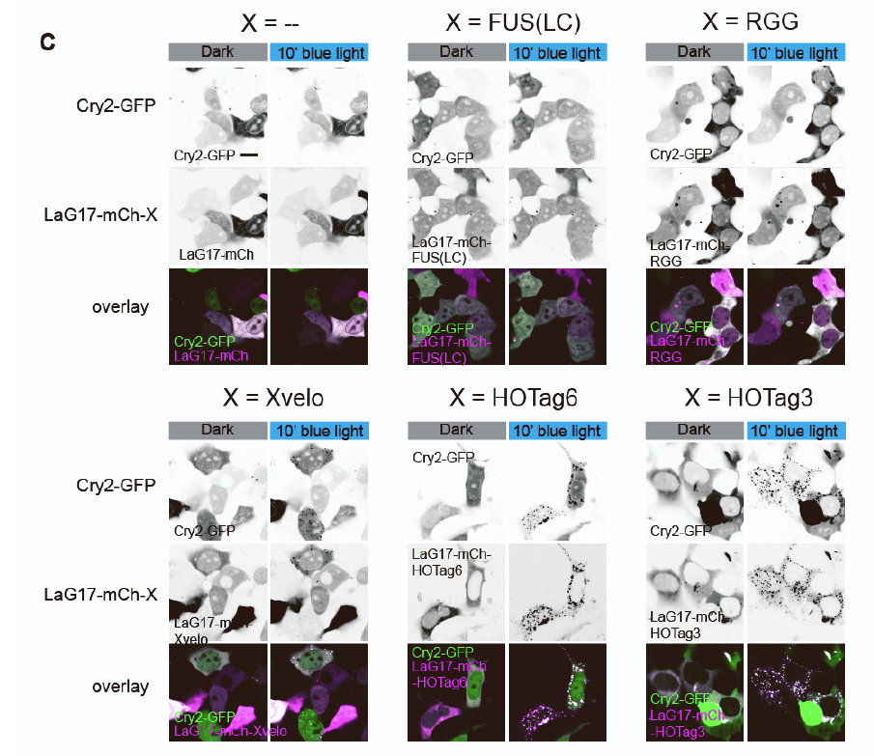
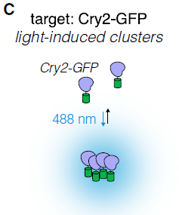

CluMPS reporter detects target protein upon clustering

Slide 7
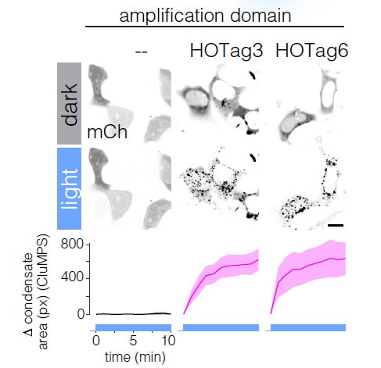
CluMPS reporter detects target protein upon clustering

Slide 8
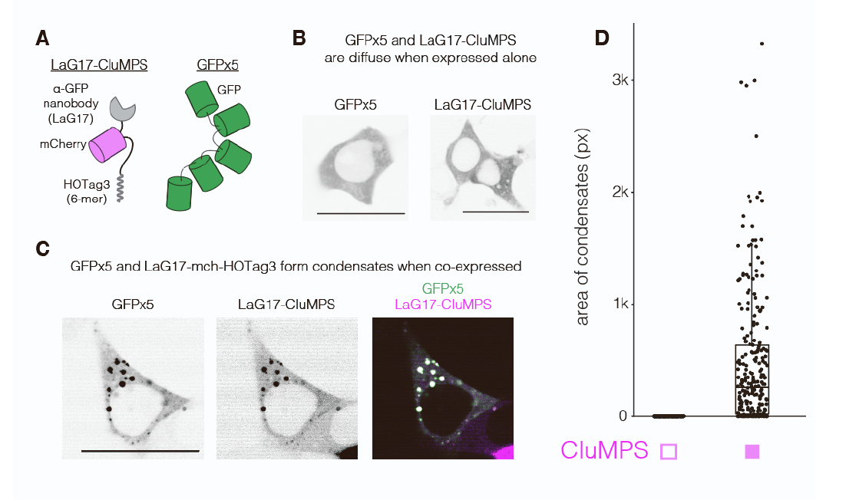
CluMPS reporter amplifies target aggregates signal via phase-phase separation of concentrated droplets

Slide 9
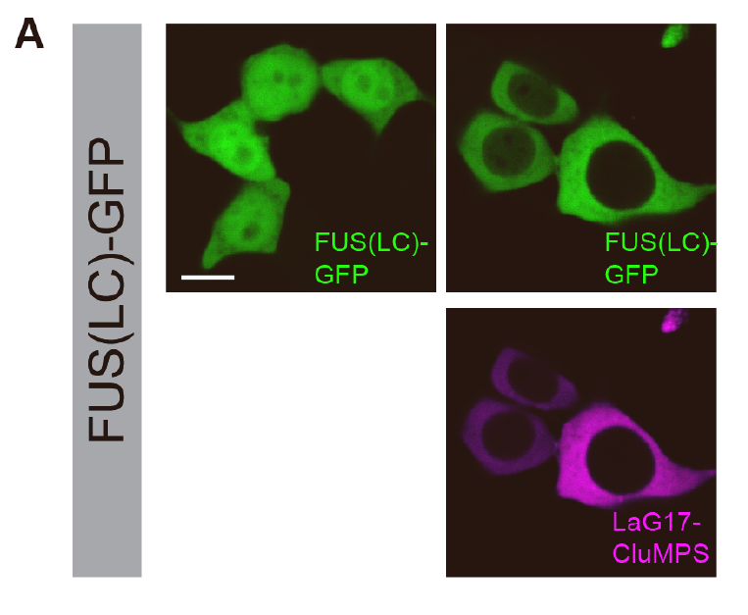
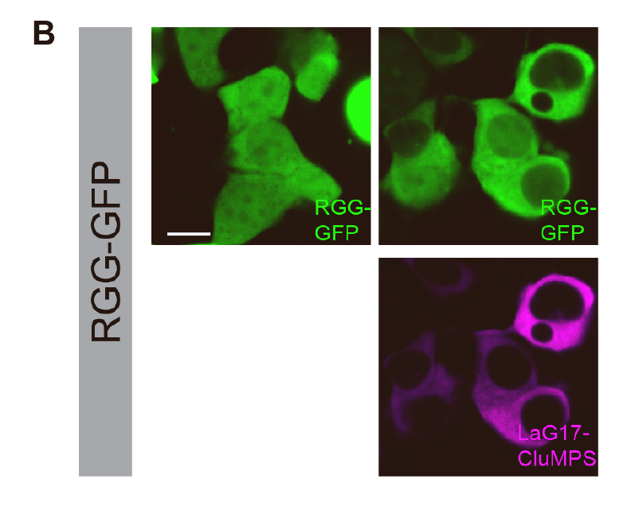
CluMPS reporter alone does not trigger target protein aggregation
- CluMPS
+ CluMPS
- CluMPS
+ CluMPS
FUS(LC) and RGG are monomeric intrinsically disordered protein that display high self-affinity (they phase separate when multimerized or overexpressed)

Slide 10
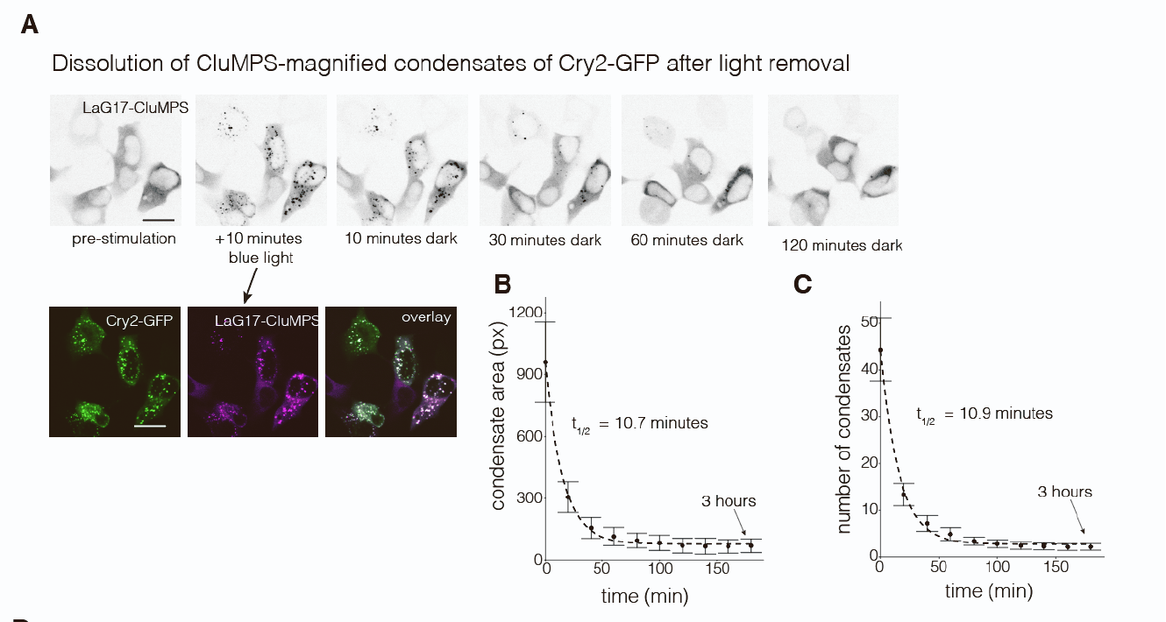
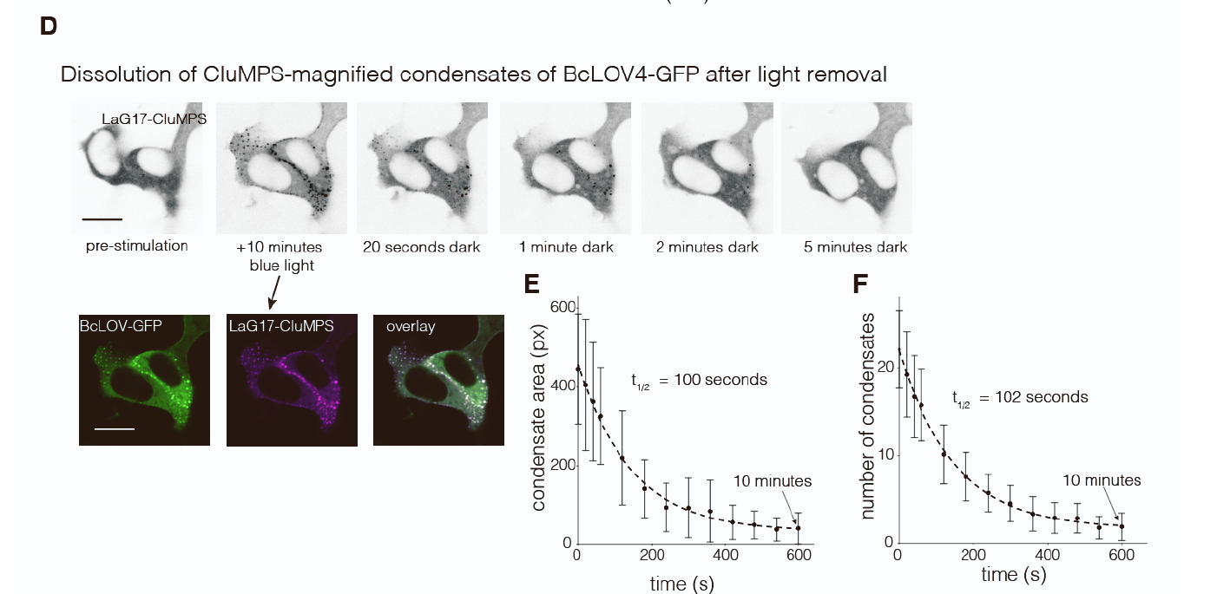
CluMPS reporter is able to report fast kinetics
Dissolution of CluMPS -CRY2-GFP condensates upon light removal
Dissolution of CluMPS –BcLOV4-GFP condensates upon light removal

Slide 11
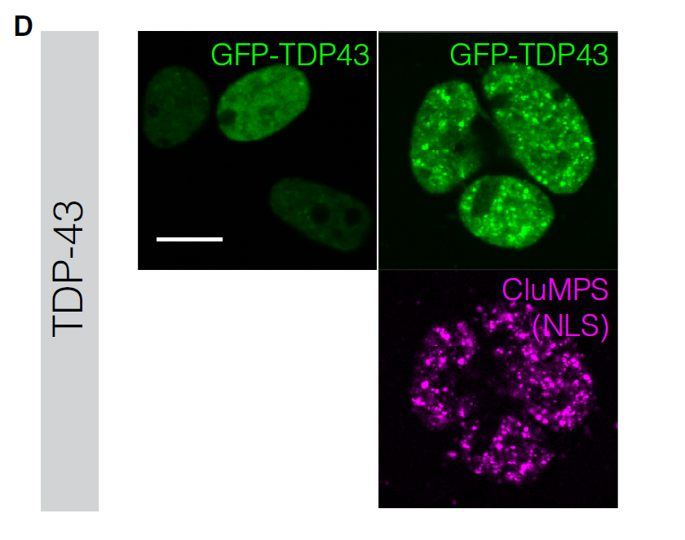
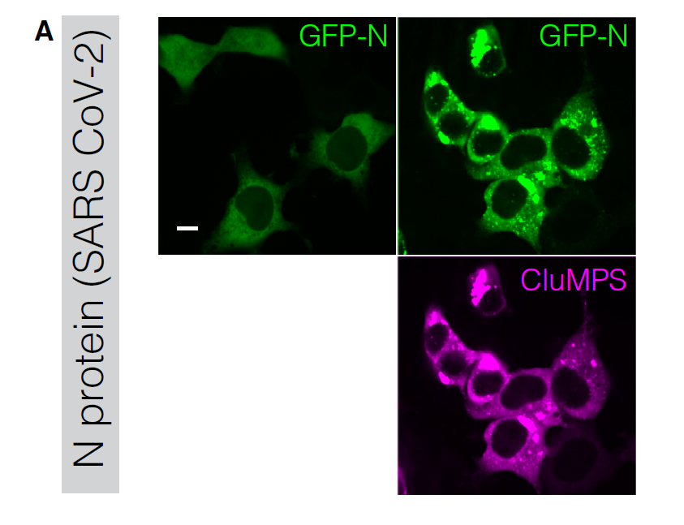
Proof-of-concept experiments #1-2:
CluMPS reporter can detect small clusters of target protein otherwise invisible to conventional fluorescent microscopy
- CluMPS
+ CluMPS
- CluMPS
+ CluMPS

Slide 12
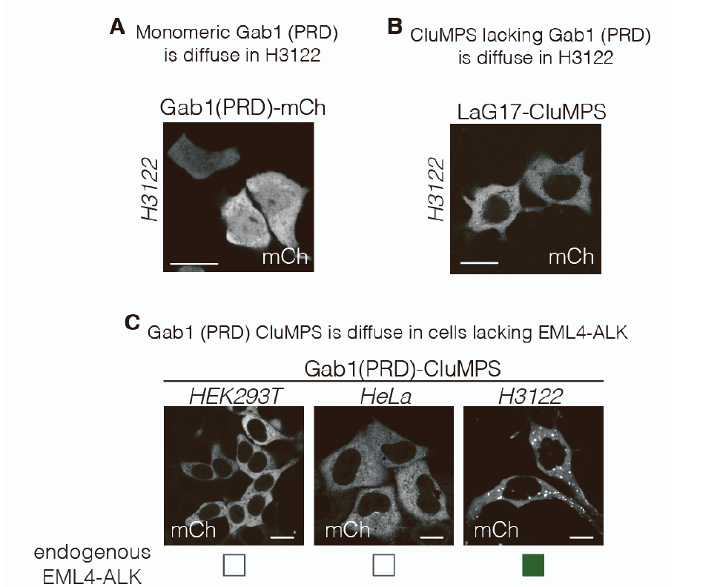
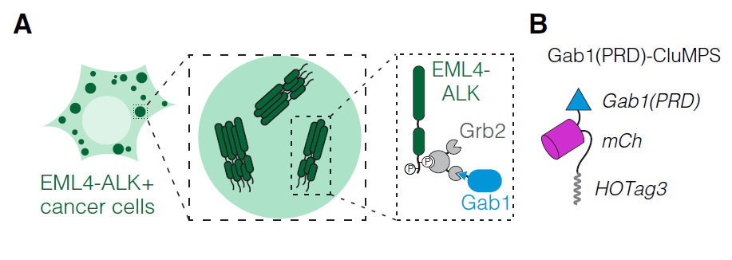
Proof-of-concept experiment #3:
CluMPS reporter can detect small clusters of endogenous unmodified target protein
(no HOTag3)
CluMPS detects Gab1 as a proxy of EML4-ALK phosphorylated aggregates

Slide 13
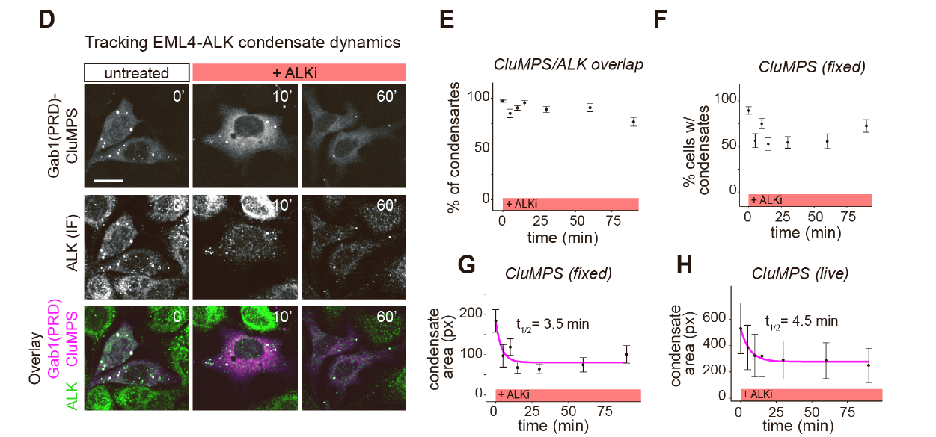
Proof-of-concept experiment #3:
CluMPS reporter can track dynamics of endogenous target protein aggregation
ALK inhibitor crizotinib

Slide 14
Summary
CluMPS reporter advantages:
Highly sensitive
Simple design and implementation (plug-and-play)
Does not require specialized equipment for imaging (40X confocal)
Can be used in alive cells
Fast kinetics
CluMPS reporter limitations:
Nanobody availability (only tested against GFP and Gab1)
GFP-tagging of protein targets may introduce impair protein function and interaction
CluMPS-induced phase-phase separation may impede functionally relevant soluble interactors

Slide 15
Summary
CluMPS reporter advantages:
Highly sensitive
Simple design and implementation (plug-and-play)
Does not require specialized equipment for imaging (40X confocal)
Can be used in alive cells
Fast kinetics
CluMPS reporter limitations:
Nanobody availability (only tested against GFP and Gab1)
GFP-tagging of protein targets may introduce impair protein function and interaction
What if we also want to manipulate target endogenous protein?
CluMPS-induced phase-phase separation may impede functionally relevant soluble interactors

Slide 16
Summary
CluMPS reporter advantages:
Highly sensitive
Simple design and implementation (plug-and-play)
Does not require specialized equipment for imaging (40X confocal)
Can be used in alive cells
Fast kinetics
CluMPS reporter limitations:
Nanobody availability (only tested against GFP and Gab1)
GFP-tagging of protein targets may introduce impair protein function and interaction
What if we also want to manipulate target endogenous protein?
CluMPS-induced phase-phase separation may impede functionally relevant soluble interactors

Slide 17
Lack of tools for straightforward visualization and manipulation of endogenous proteins in vivo:
Limitations of traditional immunodetection for microscopy:
  fixed tissue only
  primary Ab availability bottleneck
Limitations of endogenous fusion protein (e.g. GFP, degron) approach for live microscopy and target protein manipulation:
  steric hindrance of large proteins may harm target protein folding and function
  requires laborious in-frame knock-in of large insert -> low efficiency
  Lack of flexibility -> each application requires re-derivation of new alleles

Slide 18
Lack of tools for straightforward visualization and manipulation of endogenous proteins in vivo:
Limitations of traditional immunodetection for microscopy:
  fixed tissue only
  primary Ab availability bottleneck
Limitations of endogenous fusion protein (e.g. GFP, degron) approach for live microscopy and manipulation:
  steric hindrance of large proteins may harm target protein folding and function
  requires laborious in-frame knock-in of large insert -> low efficiency
  Lack of flexibility -> each application requires re-derivation of new alleles
GEARs: Genetically Encoded Affinity Reagents ->
Toolbox of small epitopes tags and their cognate tag-binders
Multifunctional -> same reagents allow for detection and manipulation of target
Versatile and specific -> same binders recognize every possible target with high affinity
Works in vivo (and fixed)
Easily deployable in vivo
No steric hindrance and no overexpression of the target
Can multiplex

Slide 19
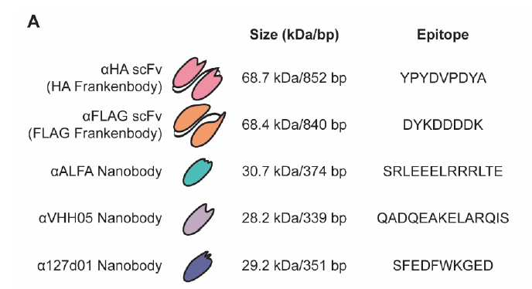
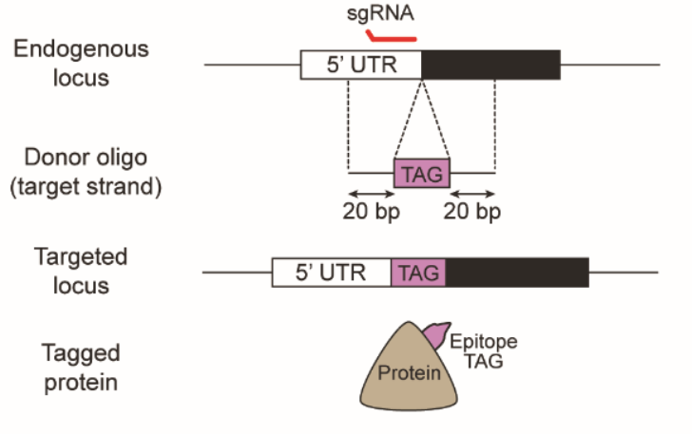
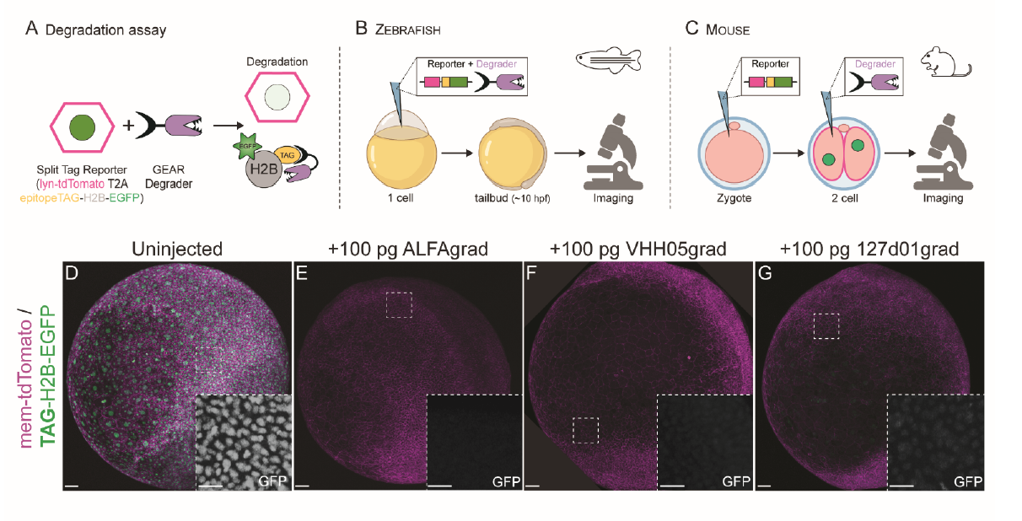
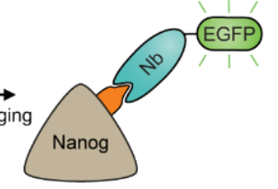


GEARs is a platform consisting of small epitope tags and their congnate intracellular binders
GEARs design:
Small epitope fused with endogenous target protein -> small epitope minimize steric hindrance
Library of anti-tag intracellular binders (Nbs or scFv) fused with an effector domain

Slide 20
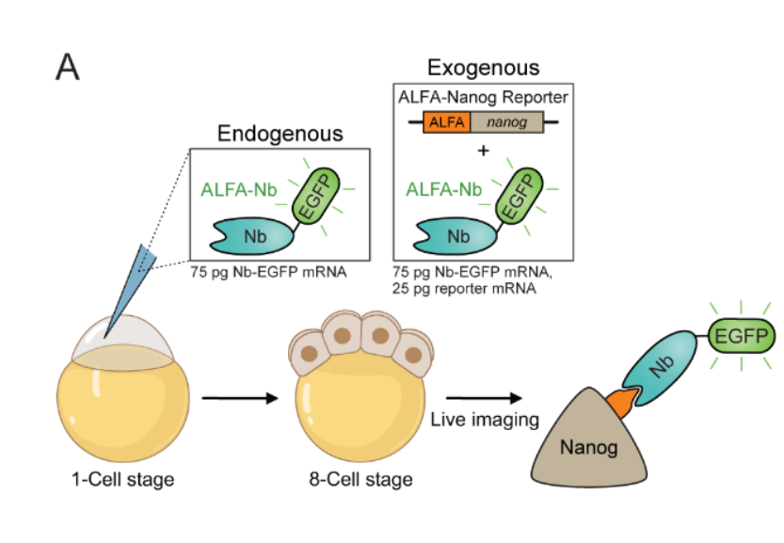
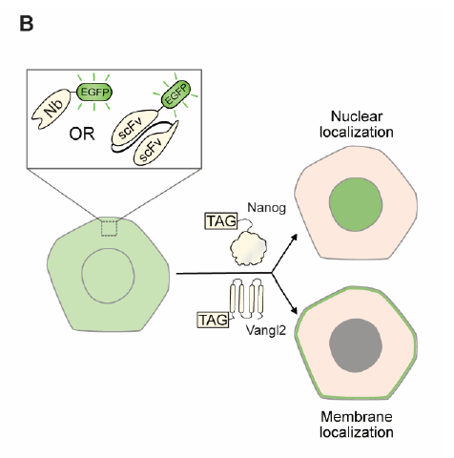
GEARs is functional and non-toxic in vivo against exogenous protein target

Slide 21
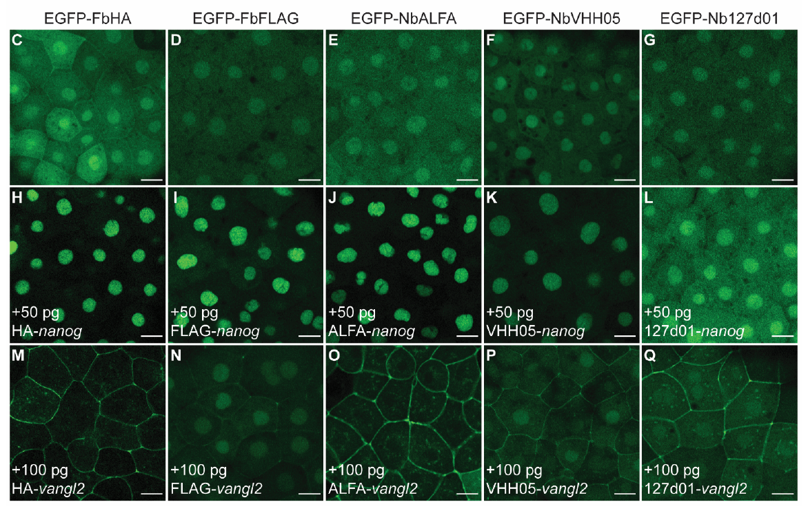
GEARs binders are functional and non-toxic in vivo
All binders recognize their targets (NbALFA most robust)
Binders are not excluded from cell compartments (diffuse w/o tag)
Binders fold properly in the cytoplasm at 28°C
No phenotype upon binders expression -> non-toxic

Slide 22
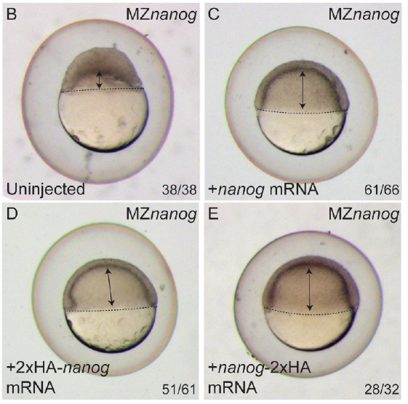
GEARs binders are functional and non-toxic in vivo
MZnanog mutant fish arrest growth after gastrulation (B)
Development was rescued by exogenous tagged nanog -> tagged protein retain functionality
No toxic effects upon binders expression nor protein tagging (rescue MZnanog mutant)

Slide 23
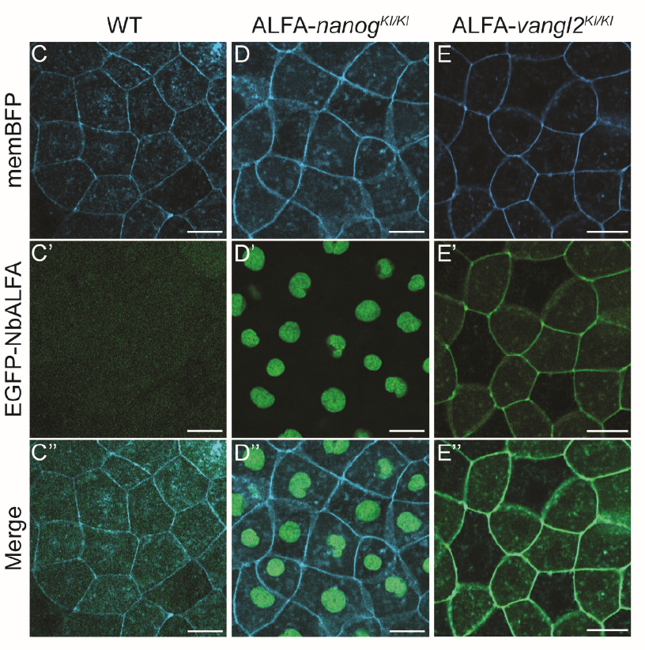
GEARs binders can detect endogenous proteins

Slide 24
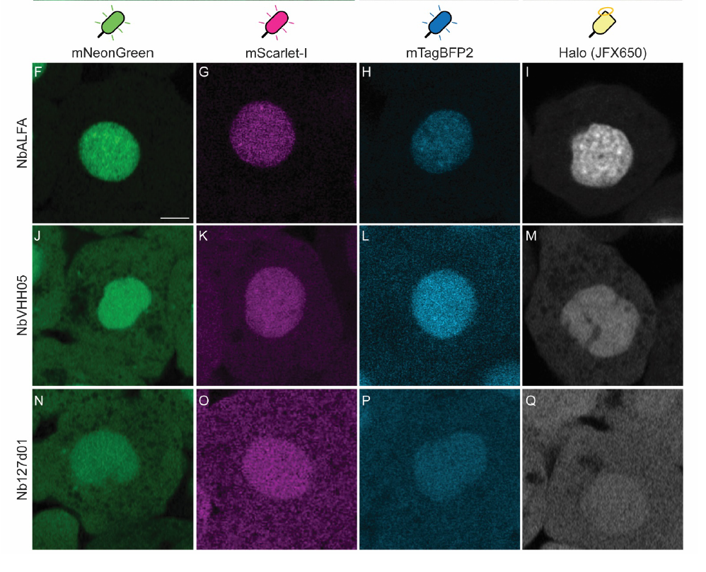
GEARs binders are versatile and can be fused with different effector domains
HaloTag protein is a modified bacteria haloalkane dehalogenase able to covalently bind synthetic HaloTag ligands containing a chloroalkane linker
HaloTag ligans can be fused with fluo proteins for pulse-and-chase exp, immobilized to surfaces for protein isolation and pull-down assays,…

Slide 25
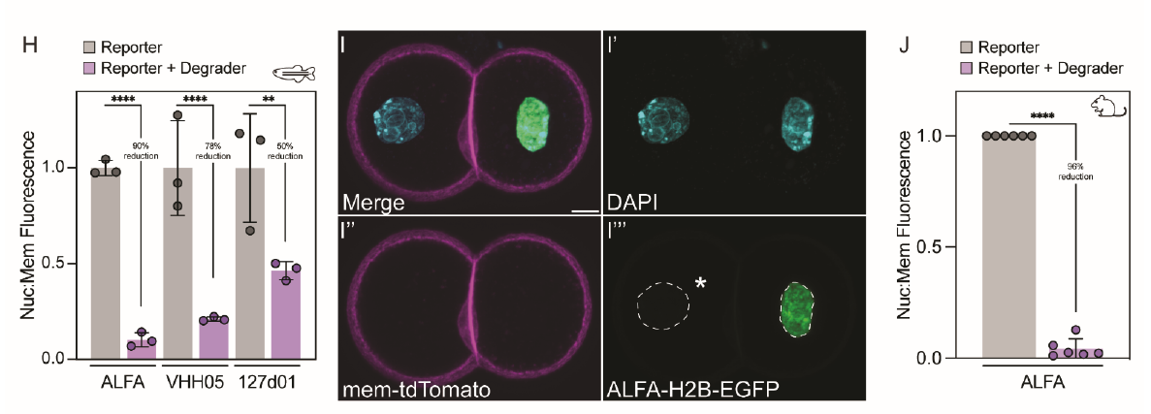
GEARs binders are versatile and can be used for targeted protein degradation in vivo

Slide 26
GEARs binders are versatile and can be used for targeted protein degradation in vivo

Slide 27
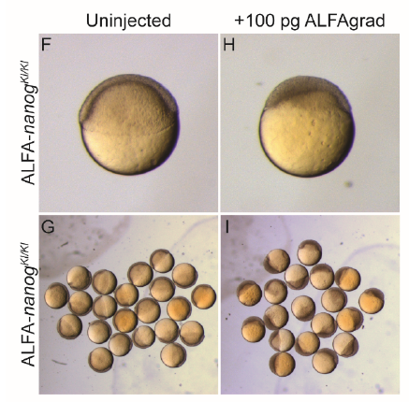
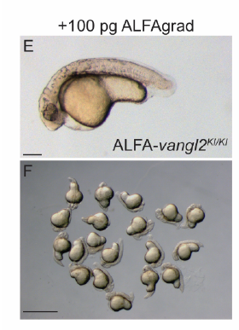
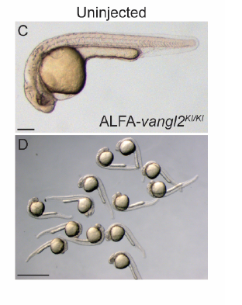
GEARs binders can be used for degradation of endogenous protein in vivo
Injection of ALFAgrad Nb into ALFA-nanog fish recapitulate LOF MZnanog phenotype (arrested epiboly)
Injection of ALFAgrad Nb into ALFA-vangl2 fish recapitulate LOF MZvangl2 phenotype
(neural tube defects)

Slide 28
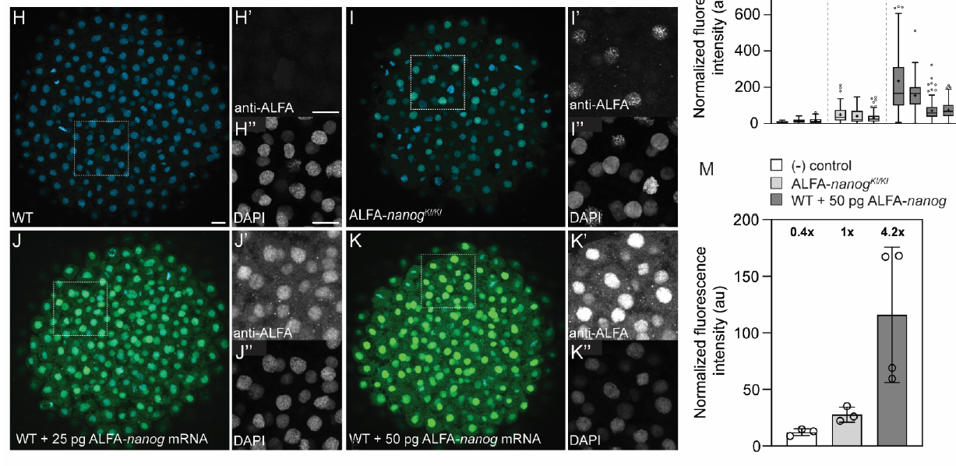
Proof-of-concept experiment:
Investigate the behavior of endogenous nanog during early zebrafish embryogenesis
(H) IF endogenous nanog w/ a-nanog Ab -> no good Ab against Zf nanog
(I) IF endogenous ALFA-nanog w/ a-ALFA GEARs Nb
(J-K) IF exogenous ALFA-nanog (amount inferred by rescue exp) w/ a-ALFA Ab -> GEARs is a more faithful reporter of endogenous protein expression levels

Slide 29
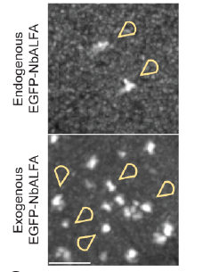
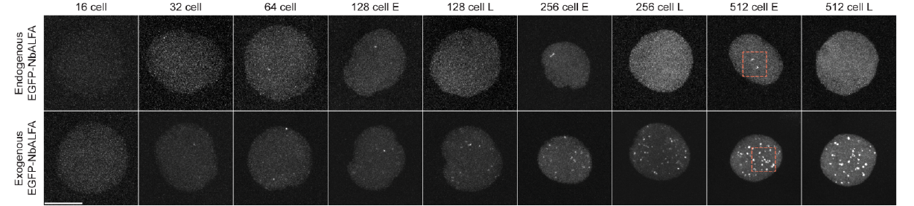
Proof-of-concept experiment:
Investigate the behavior of endogenous nanog during early zebrafish embryogenesis
miR-430 foci

Slide 30
Summary
GEARs system advantages:
Multifunctional and versatile
Circumvents primary Ab bottleneck
Simpler to implement and with limited steric hampering compared to traditional fusion protein approach
Works in vivo
Works on endogenous protein
GEARs system limitations:
Sensitivity -> higher noise due to unbound Nb
Nb delivery can be cumbersome depending on the application
Tested only on 2 proteins
Not tested for subcell localization other than cytoplasm (PM inner leaflet)and nucleus

Slide 31
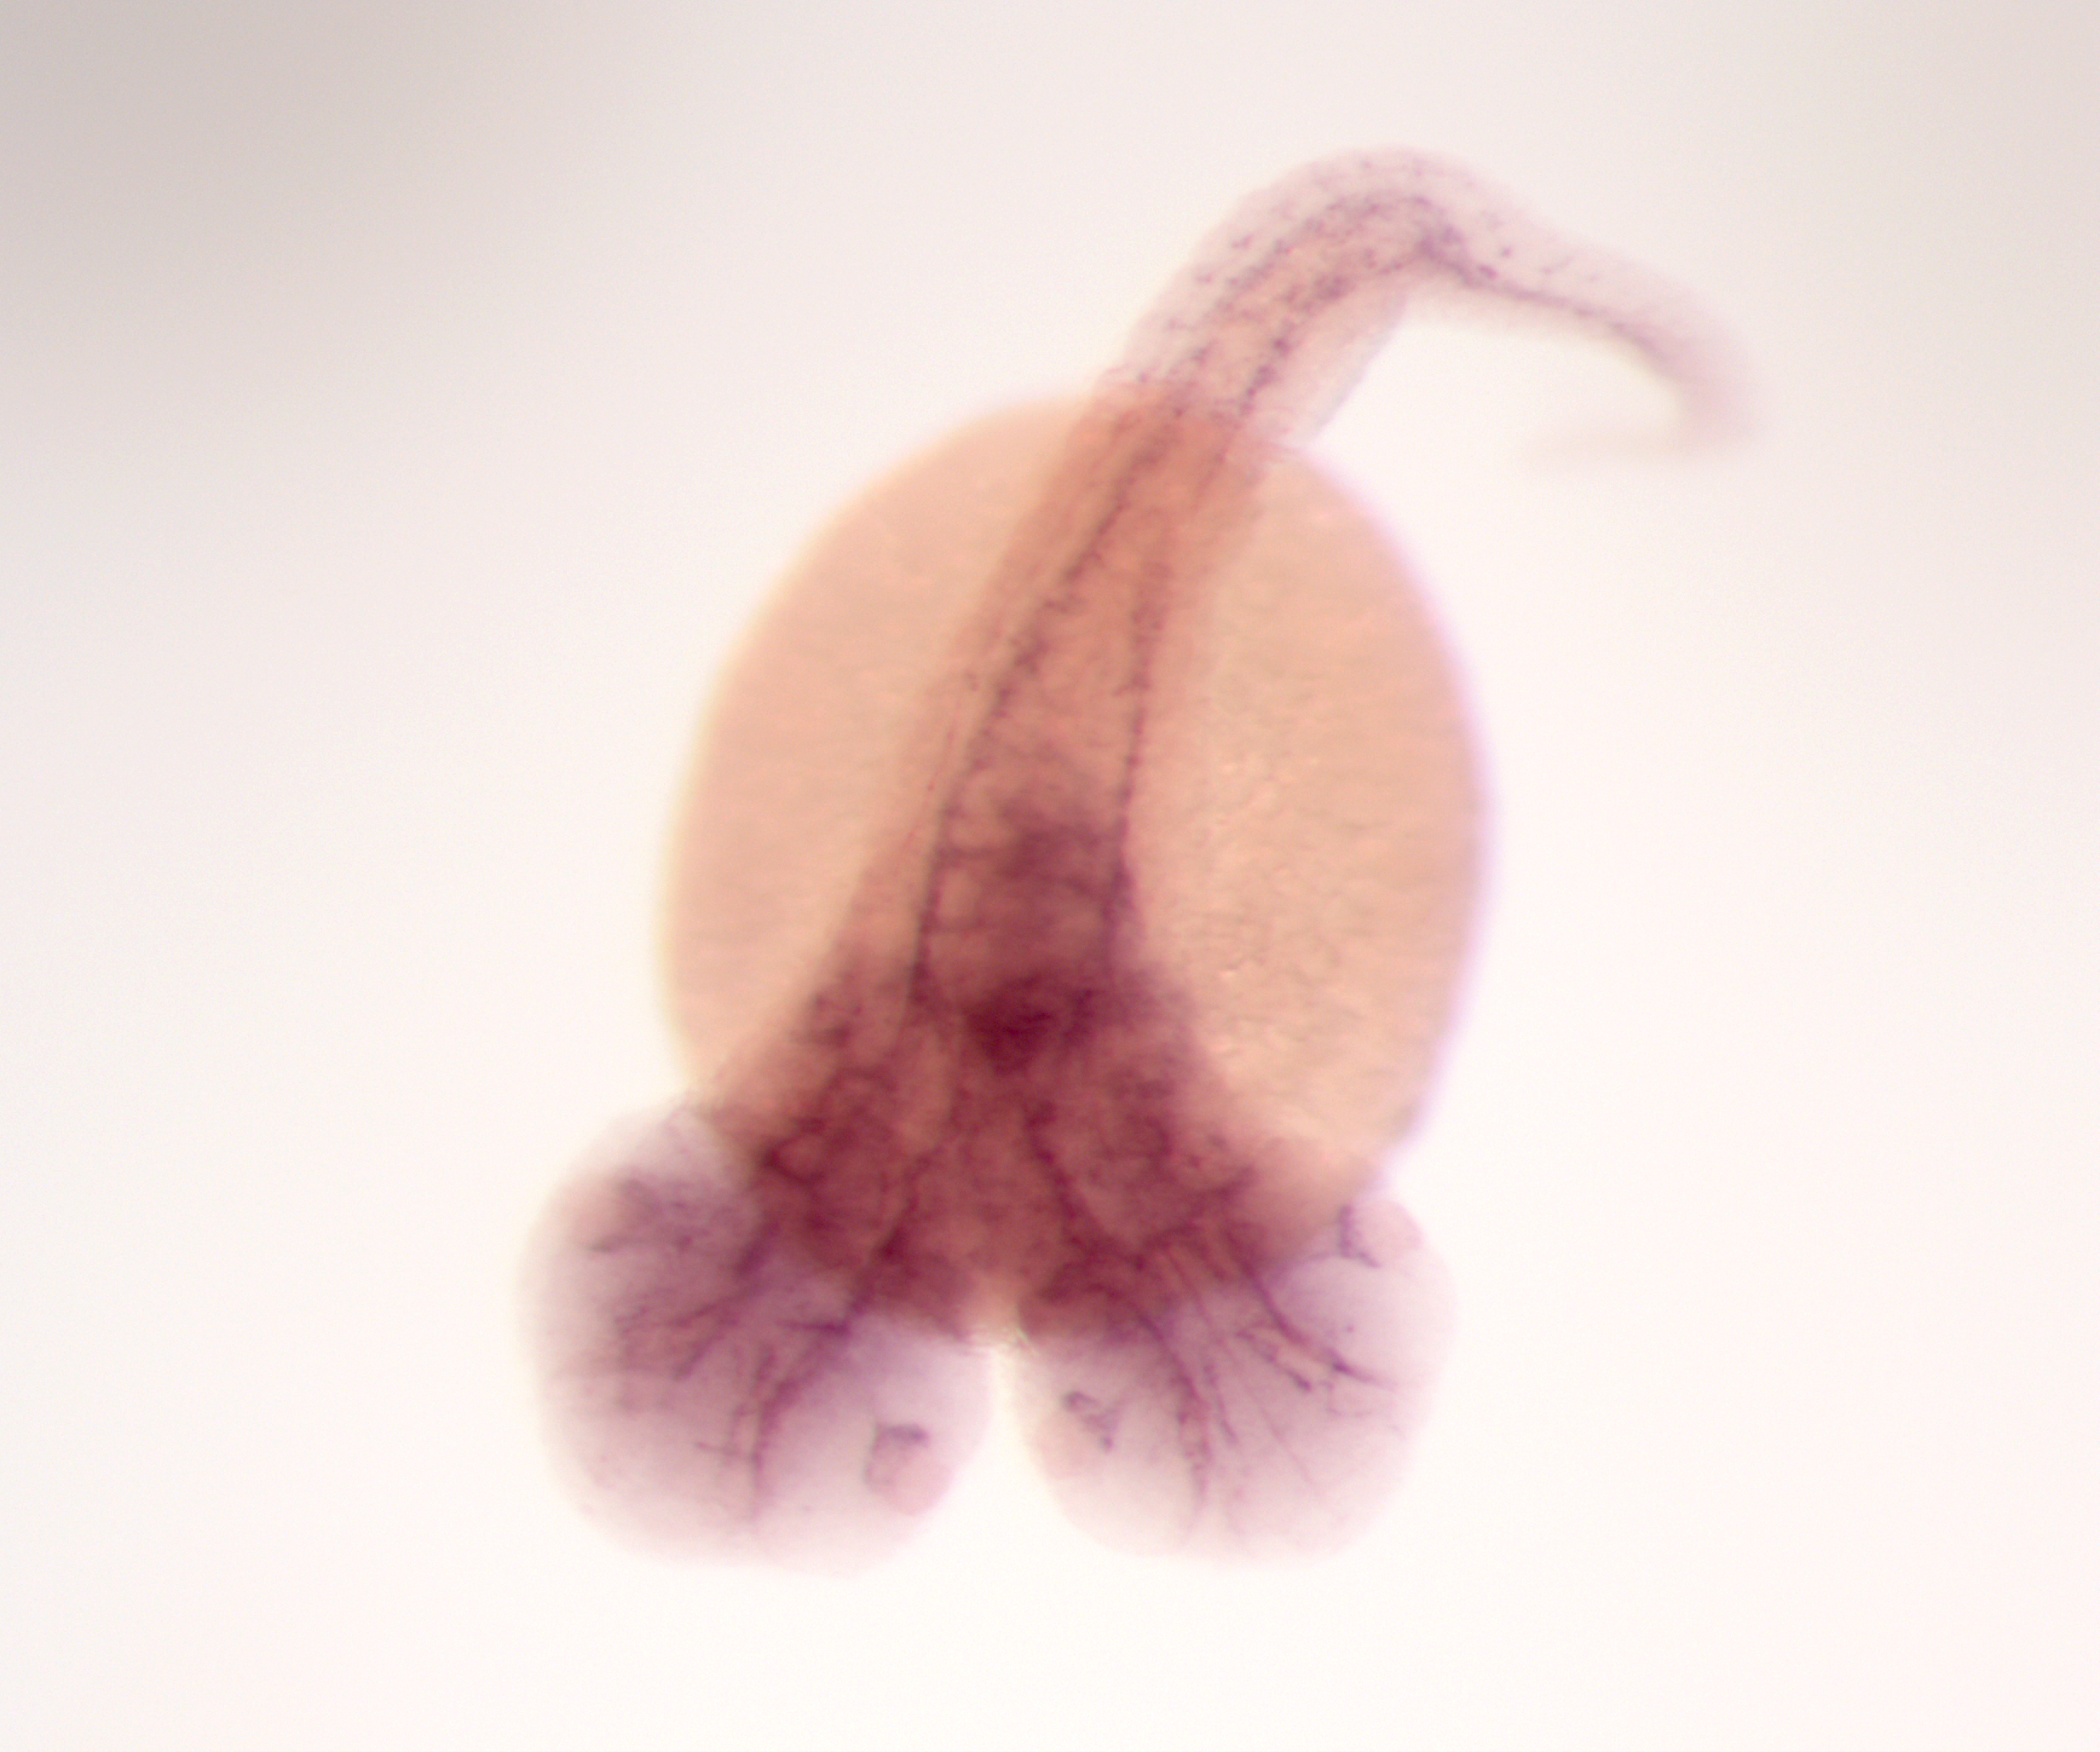
Thanks for the attention!

