Slide 1
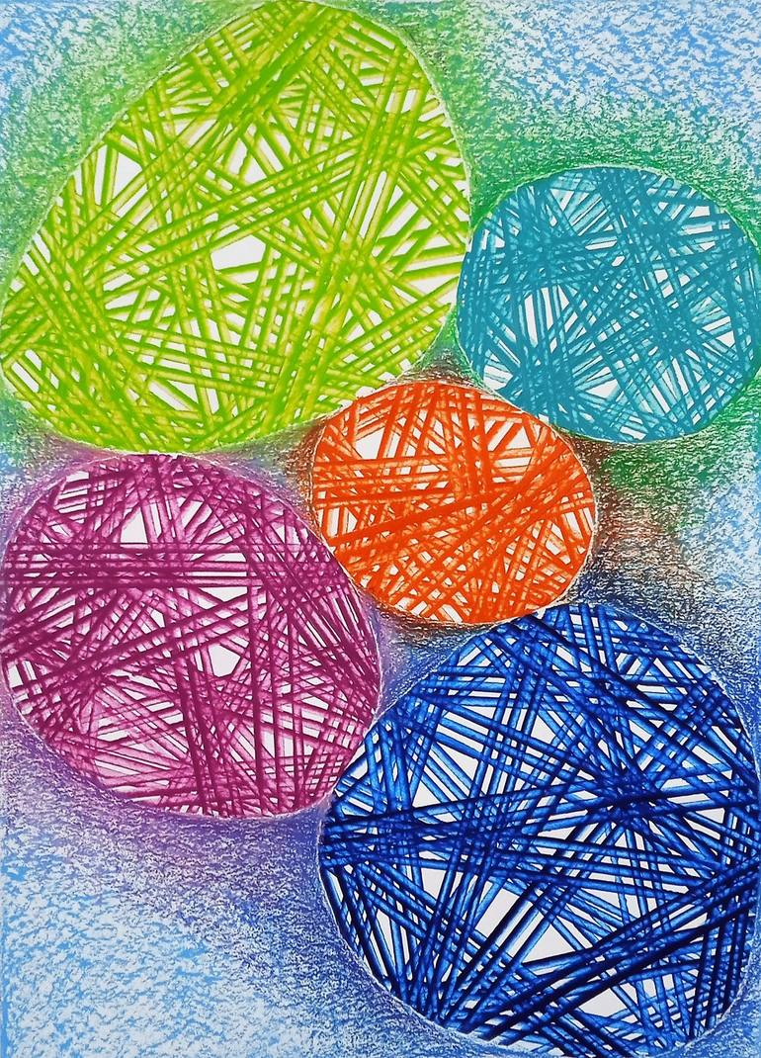
Elena De Cecco
SPHEROIDS
ADVANCEMENTS AND APPLICATIONS
Technical Journal Club – Animal series

Slide 2
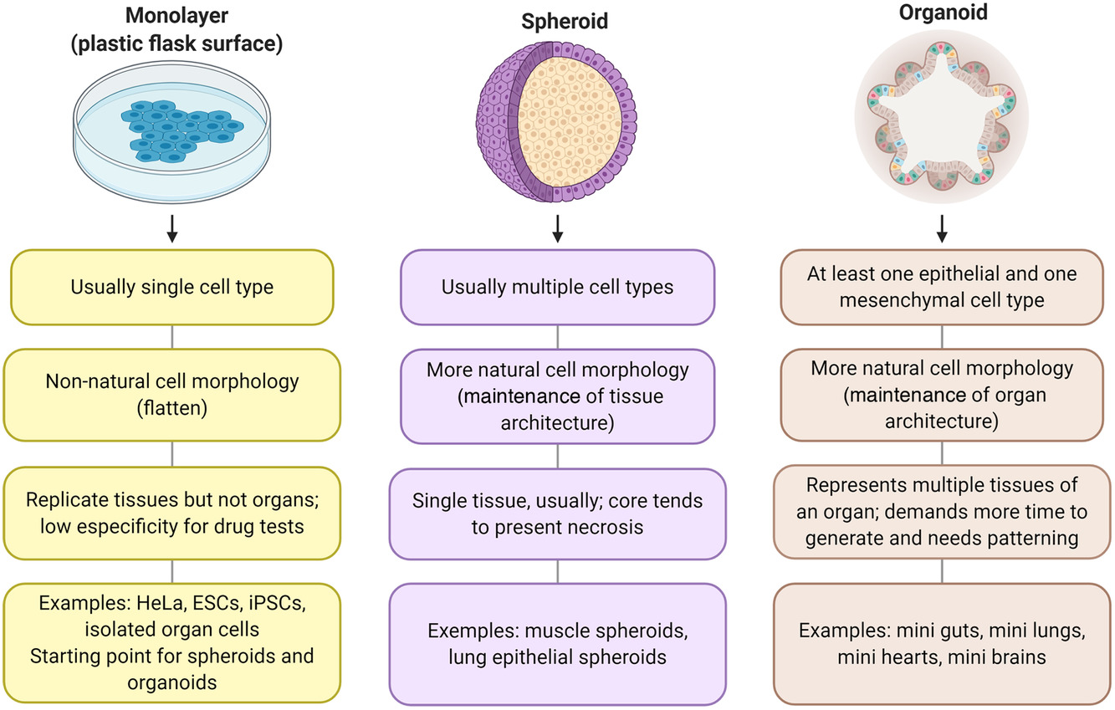
2D vs. 3D culture models

Slide 3
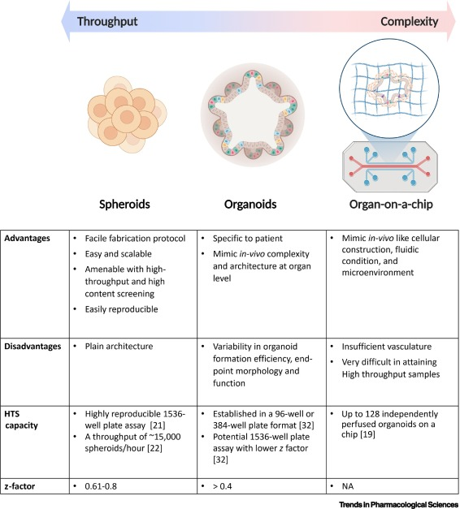
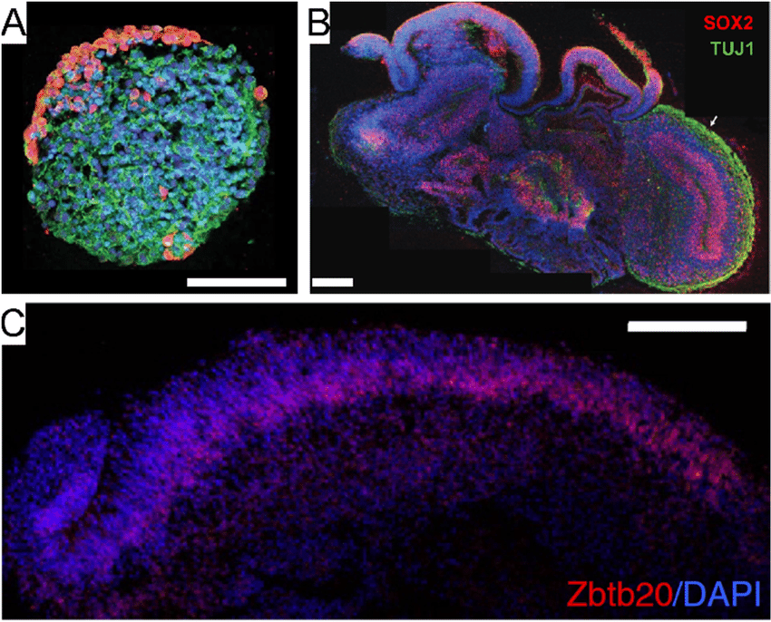
Spheroid
Forro et al., 2021
Organoid

Slide 4
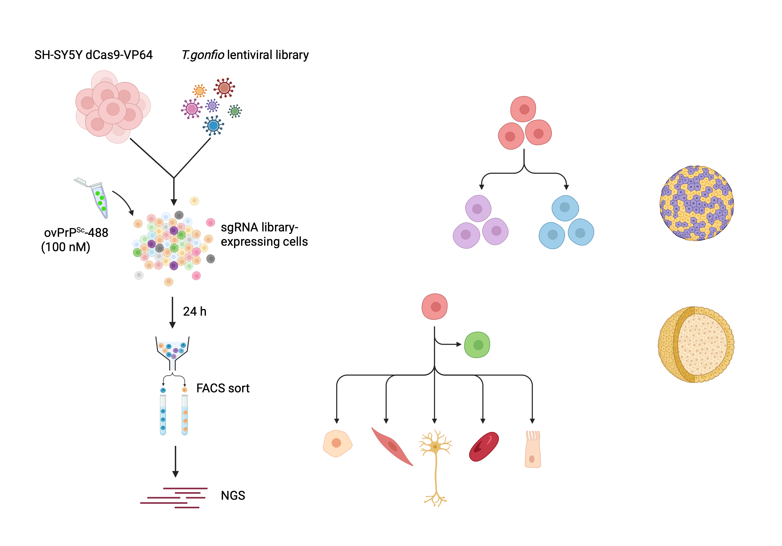
Organoids and spheroids originate from the same cell types but have distinct characteristics.
Pluripotent stem cells
Adult tissue cells
Adult stem cells
Embryonic
iPSCs
Differentiated/immortalized cells
Organoids are multi-lineage 3D cultures that self-organize in spatially complex structures resembling an organ.
Organoids are stable for long time perionds (> 1 year) due to the constant regeneration from a pool of immature progenitor cells
Spheroids are single-cell or multicellular models based on the ability of homotypical cell-cell adhesion. They form spherical structures with low spatial complexity.
Survival in culture depends on the specific spheroids (morphology, compactness).

Slide 5
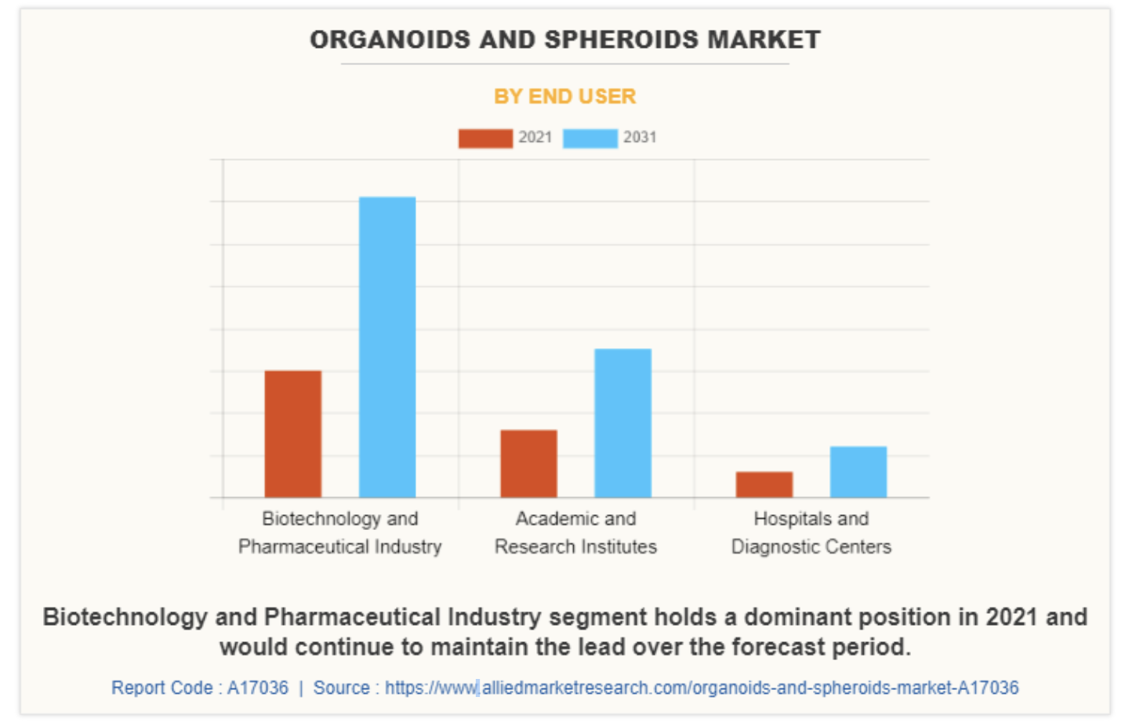
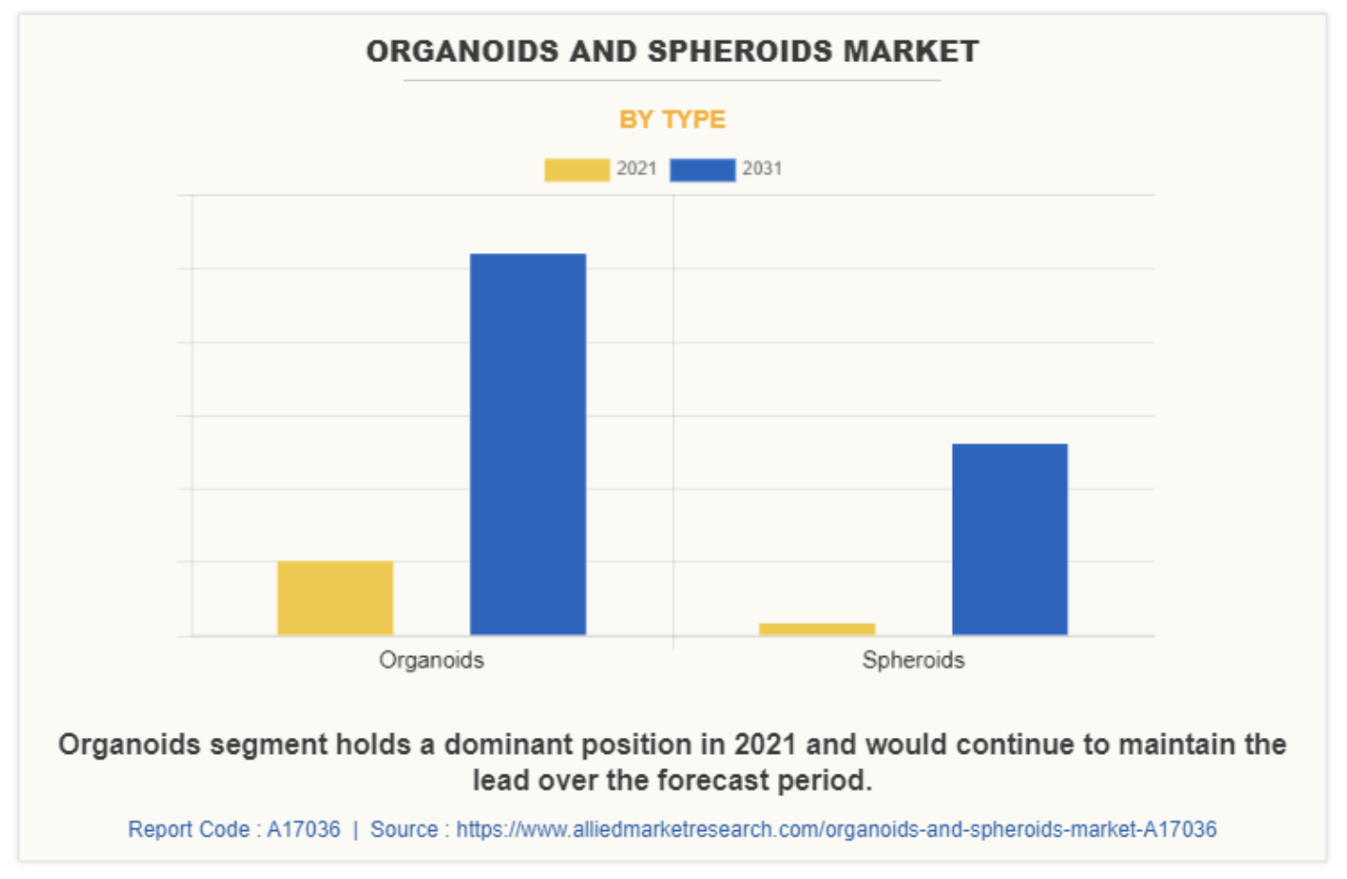
Market trends in 3D culture
Why using spheroids?
- Less expensive
- More scalable
- Can form semi-organized 3D models

Slide 6
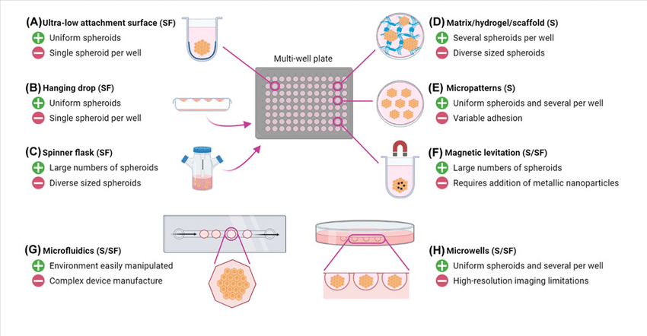
High-throughput generation of spheroids
Mysior et al., 2021

Slide 7
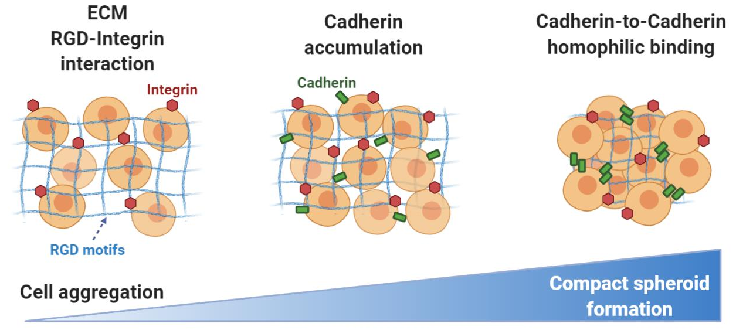
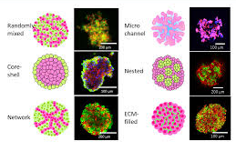
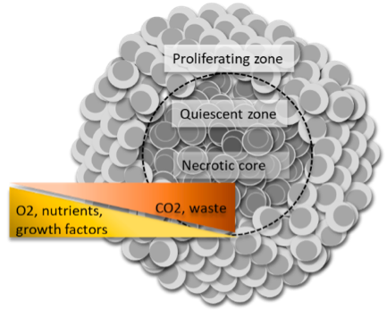
Spheroids form upon homophilic interaction of cells in suspension or growing on low adherent surfaces
Spheroids can be formed by many cell types
Inner structure of typical spheroids

Slide 8
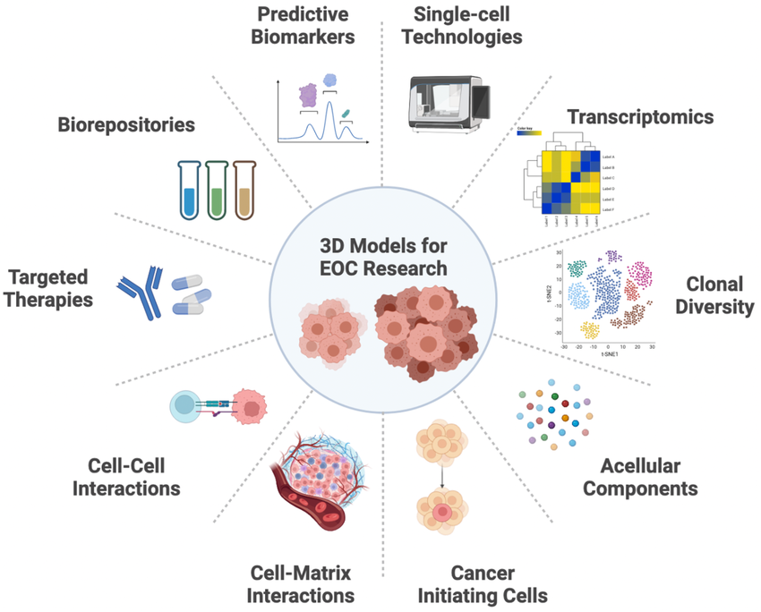

Slide 9
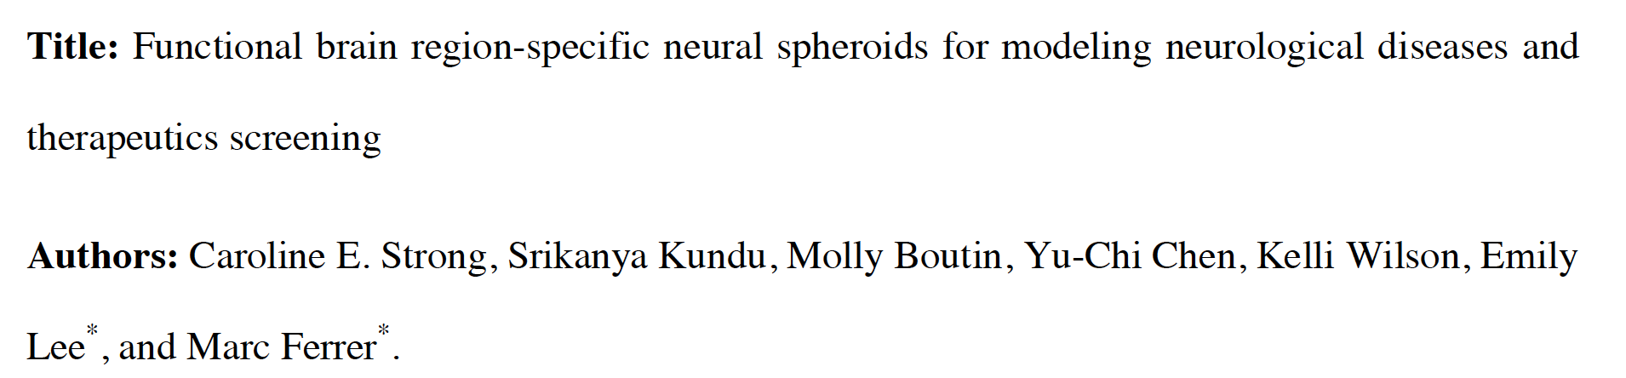
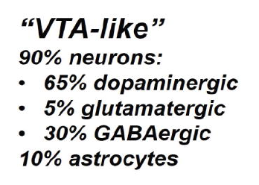
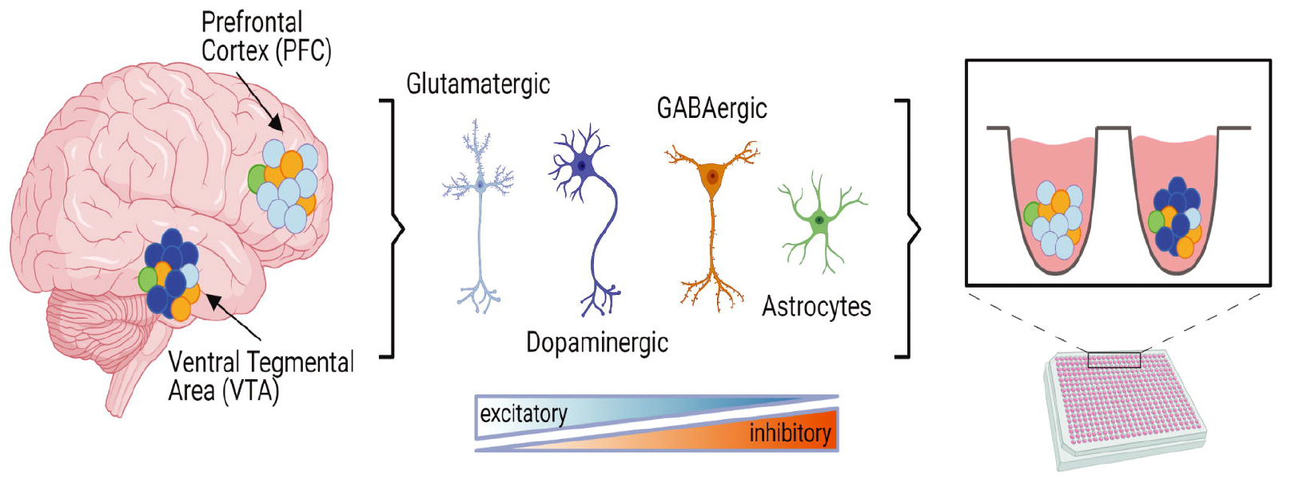
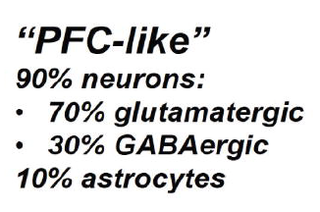
Region-specific brain spheroids
PD-like spheroids (A53T)
AD-like spheroids (APOE4)

Slide 10
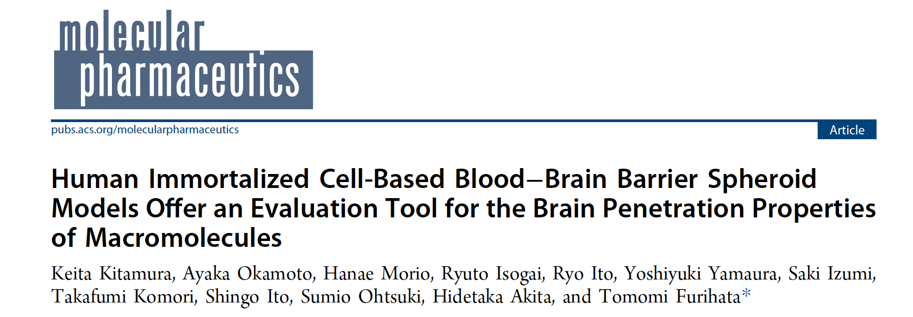
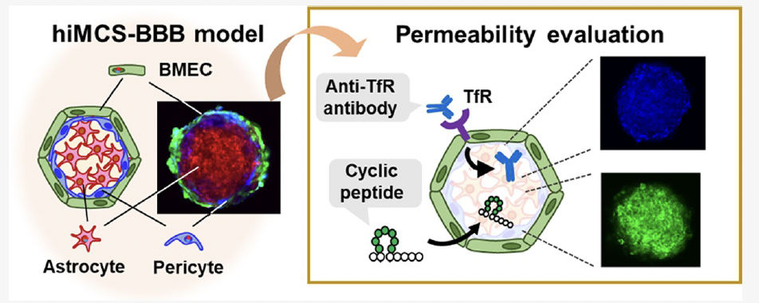

Slide 11
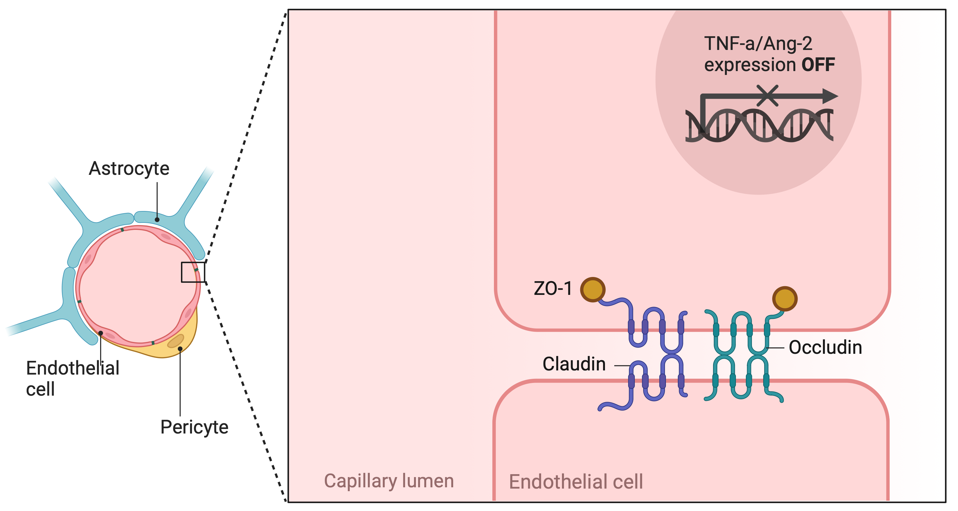
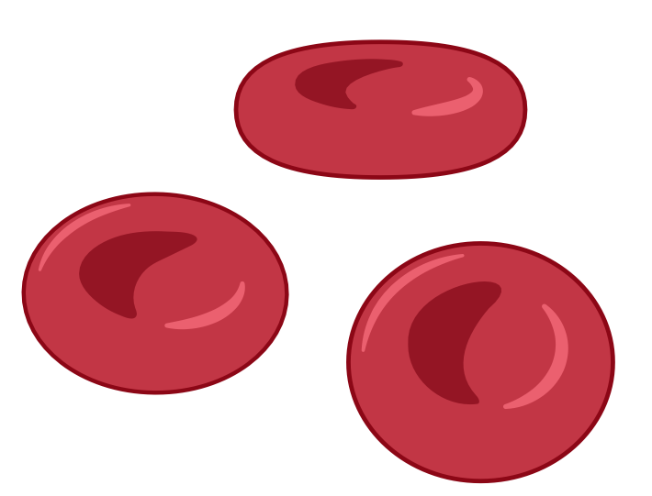
Structure of the blood brain barrier

Slide 12
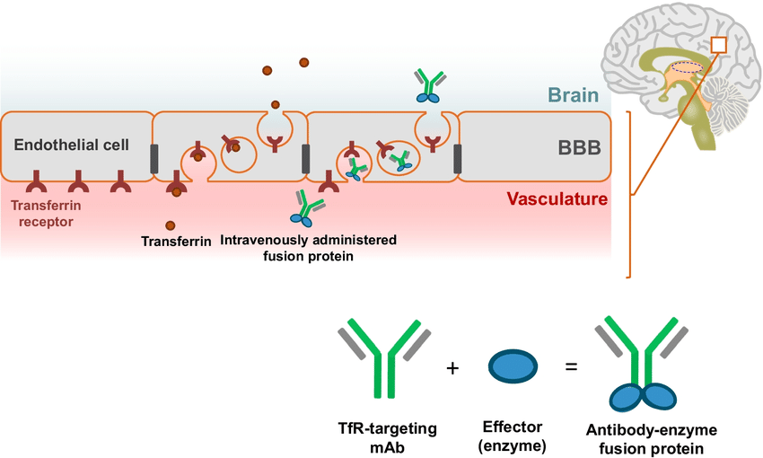
Receptor-mediated transcytosis
2D transwell models do not recapitulate the permeability features of the BBB
3D models are necessary
Transferrin and insulin receptors can be exploited to deliver drugs across the BBB

Slide 13
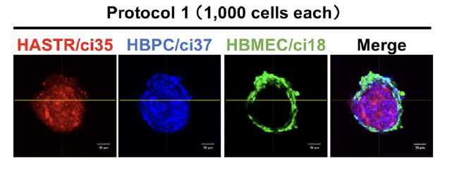
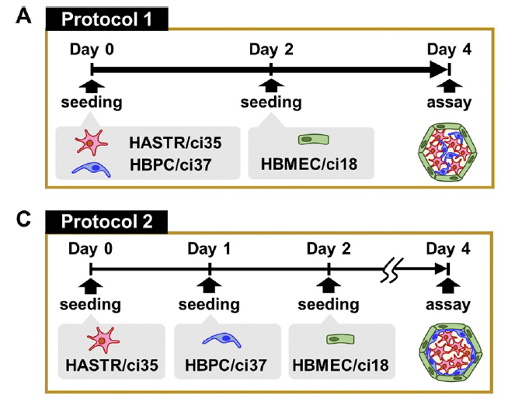
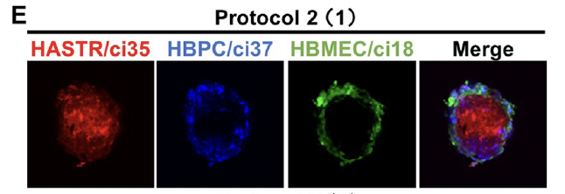
BBB spheroids are composed of three different immortalized cell populations: BMECs, astrocytes and brain pericytes
In the BBB, pericytes are distributed in a monolayer between astrocytes and BMECs
Sequential seeding of the three cell types results in a structural organization that more resembles the situation in vivo

Slide 14
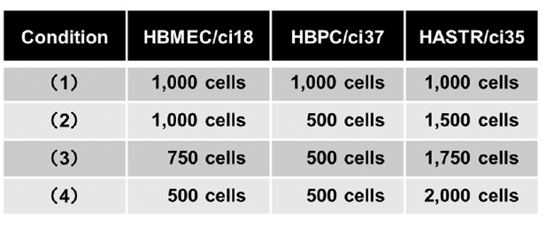
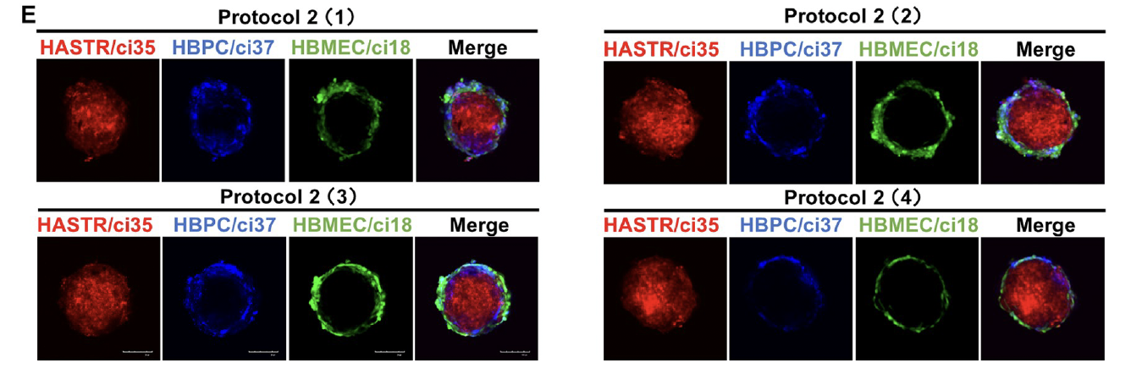
Cell numbers influence the structure of the nascent BBB spheroids
Conditions 1) and 2) show spots where cells are clumping together.
In condition 4) pericytes do not form a homogeneous layer
Condition 3) shows the best morphology

Slide 15
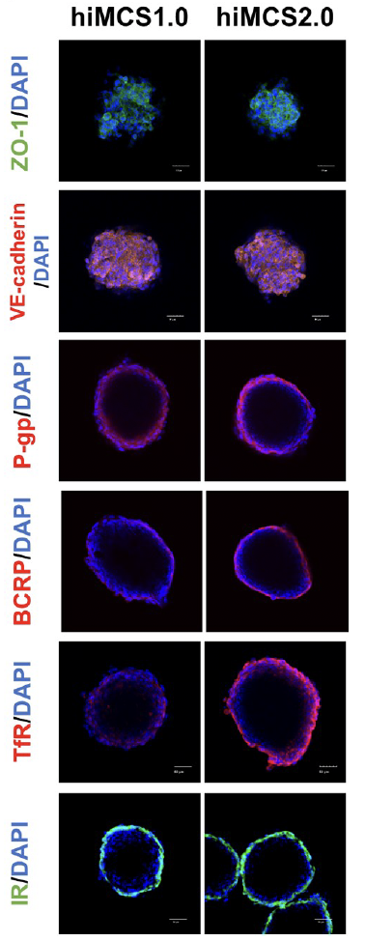
Characterization of the hiMCS2.0 model
Expression of BBB markers is comparable among the two models, but TfR and IR are slightly more expressed in the 2.0 model

Slide 16
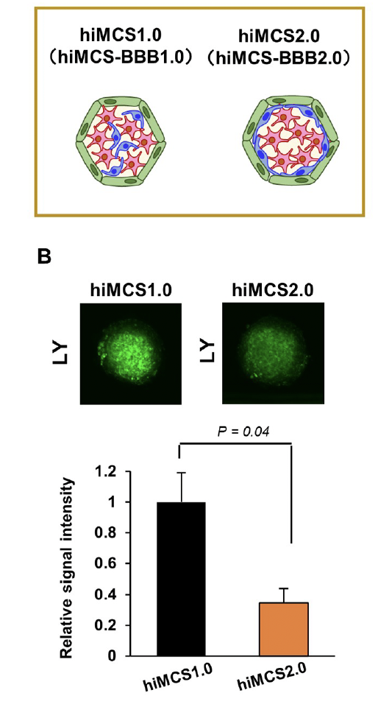
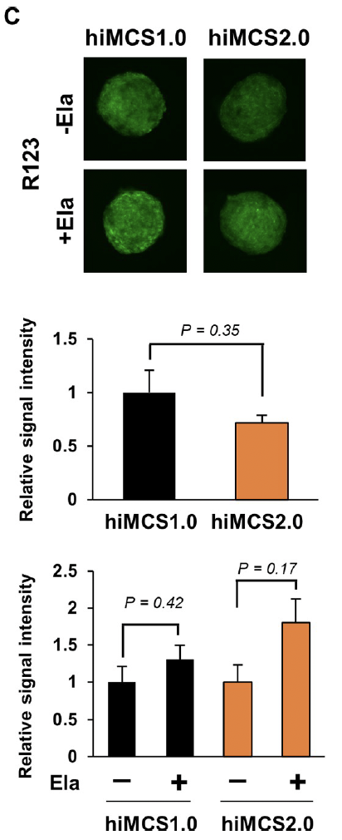
Evaluation of permeability function
BBB spheroid model (2.0) was compared to a previous model with lower intraspheroidal complexity (1.0)
Lucifer Yellow (LY) and R123 were used to check membrane permeability.
Permeability is lower in the 2.0 model
Upon inhibition of P-gp, permeability increases more in the 2.0 model

Slide 17
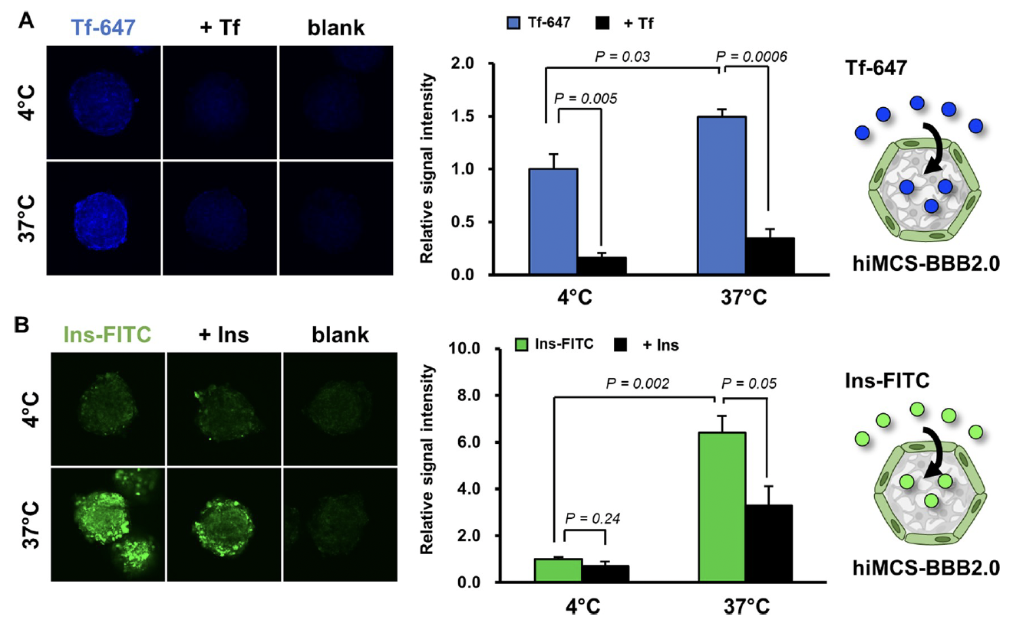
Both Tf-647 and Insulin-FITC are actively transcytosed across the epithelial layer to the inside of the spheroids. Uptake is reduced upon addition of non-labelled proteins.
Consistent upatek of Tfn-647 observed also at 4°C → unknown reason.

Slide 18
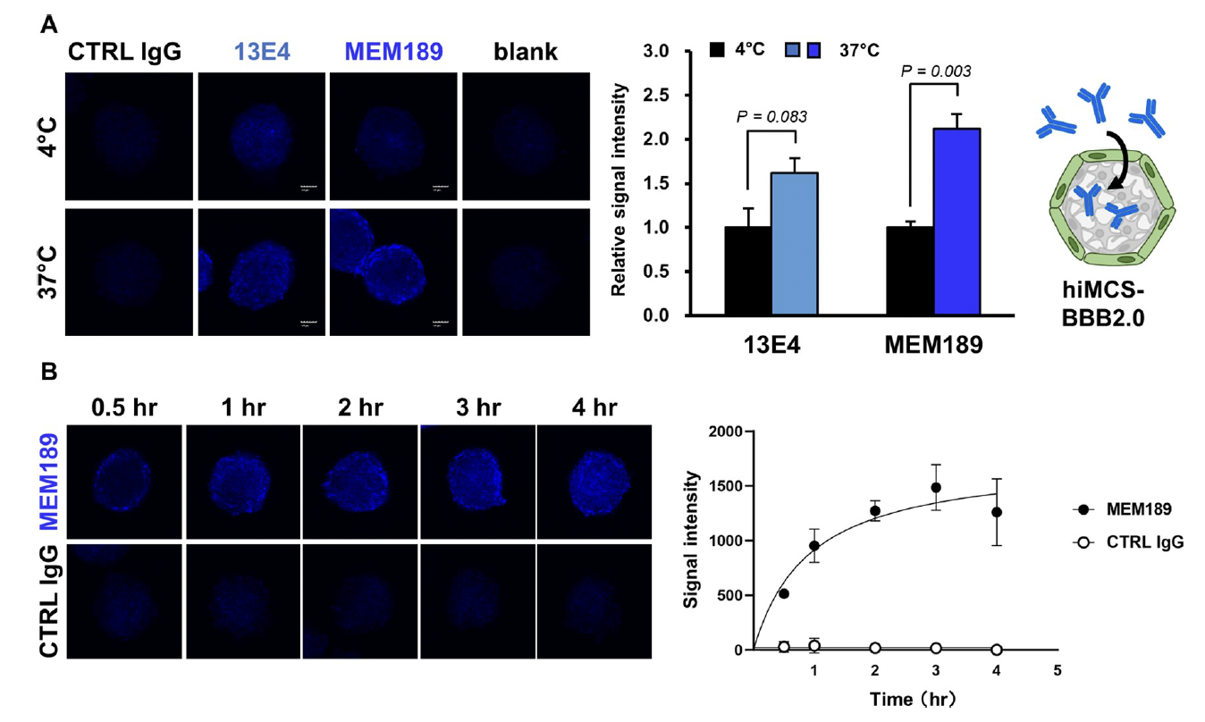
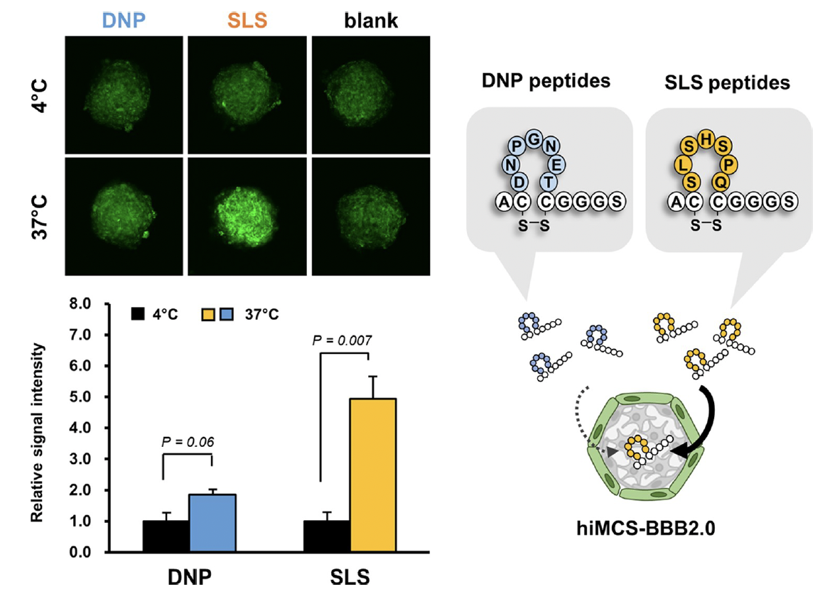
Two anti-Tfr antibodies are able to cross the BMEC layer, consistently with what described in other publications.
MEM189 antibody penetrates more efficiently than 13EA
Similarly, SLS peptide could efficiently penetrate in the spheroids, while the DNP peptide was less permeable.
These results are in agreement with previous reports.

Slide 19
Conclusions
Permeability properties of the BBB can be riproduced in vitro by generating multicellular spheroids from immortalized cells.
The use of immortalized cells makes the process scalable and robust.
Proteins that form intercellular junctions (P-gp, cadherins, ZO-1) are expressed in the in vitro BBB model.
hiMCS2.0 BBB models is not permeable to soluble fluorescent dyes.
Tfr-mediated transcytosis of middle/macromolecules can be evaluated using hiMCS2.0 BBB model thanks to its expression of the Tf receptor.
High expression of insulin receptor makes it useful to assess IR-mediated transcytosis.
Time-dependent penetration of antibodies makes it suitable to study pharmacokinetics.
Reliable method of intraspheroidal compound quantification still not available!!

Slide 20
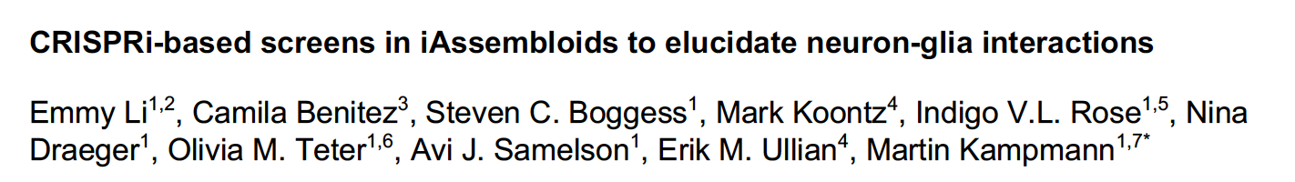
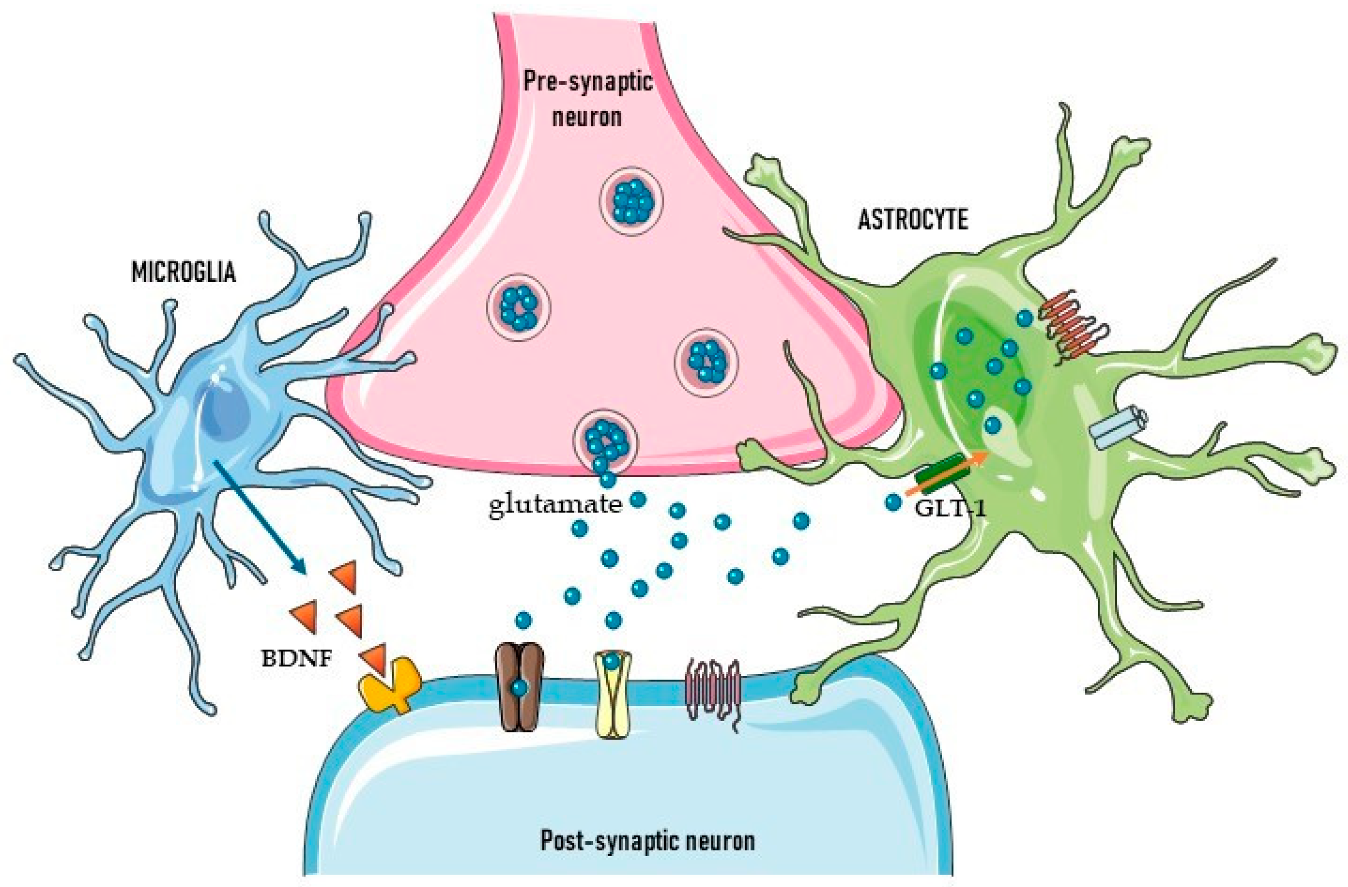

Slide 21
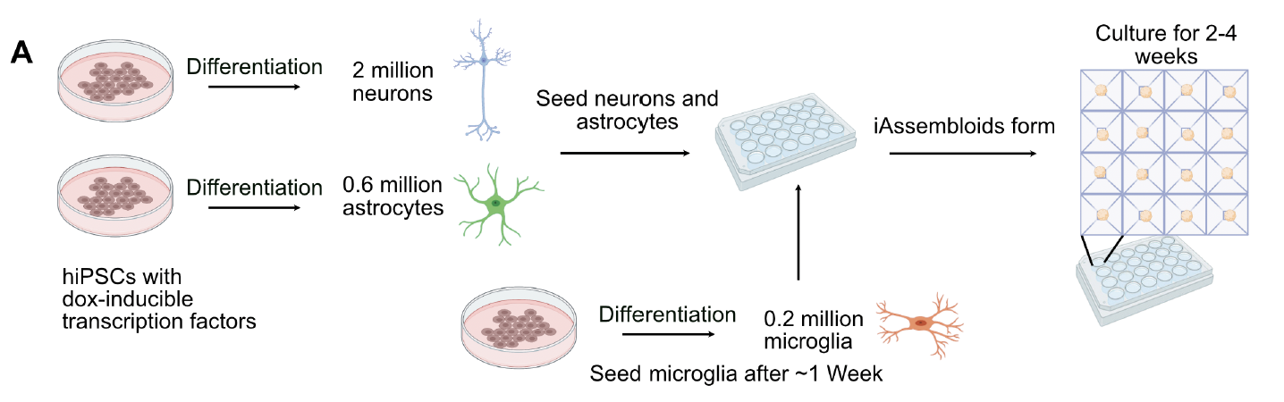
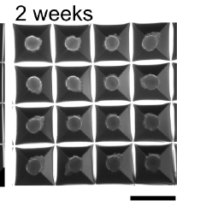
STEP I
Generation of the model
Dox-inducible NGN2 differentiation system
1:3:0.3
Astrocytes : Neurons : Glia
Two protocols:
- with serum
- serum-free
6TF induction protocol

Slide 22
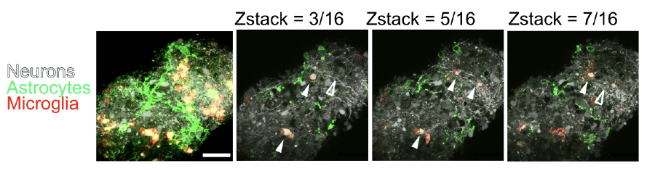
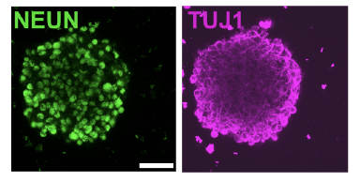
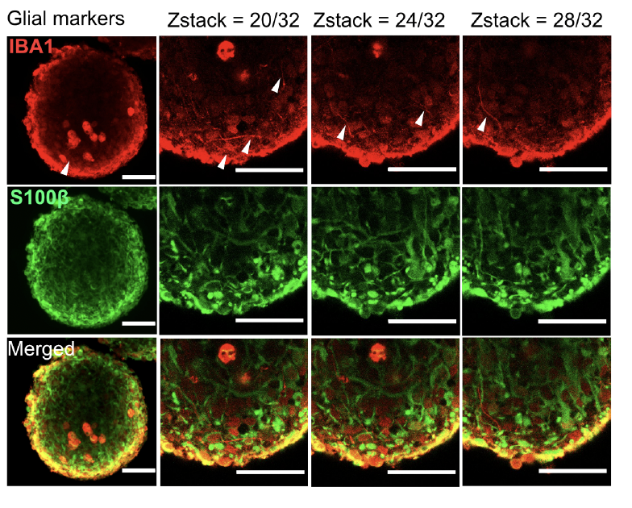
Astrocytes have a stellate morphology
Neurons develop long processes
Microglia are either amoeboid or with processes
The three cell types maintain their identity within the iAssembloids

Slide 23
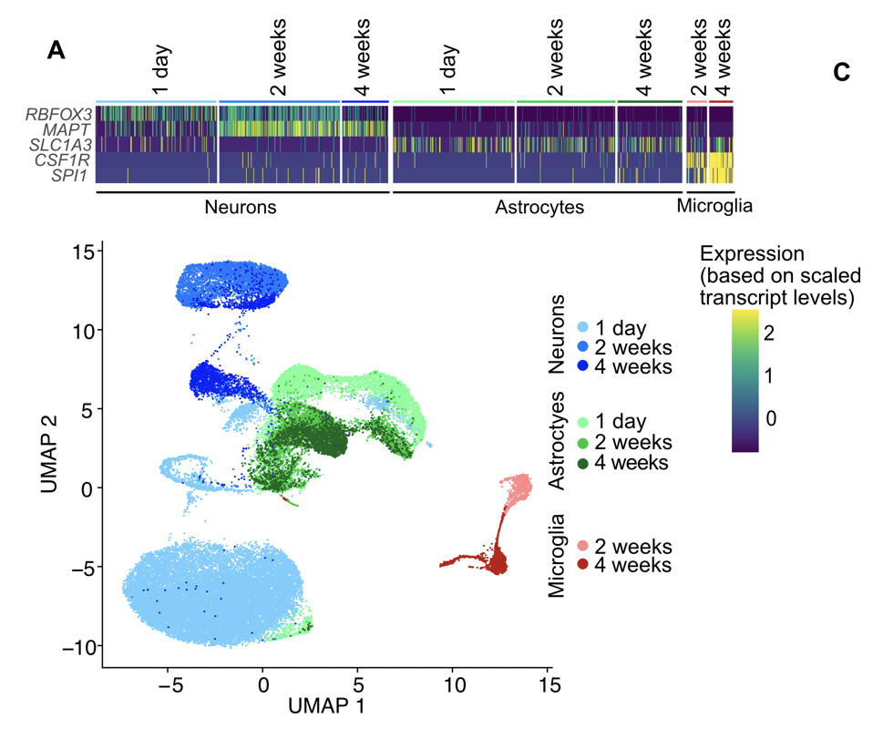
STEP II
Functional characterization of iAssembloids
snRNA sequencing to characterize gene expression of all three cell types
Cell-specific markers are retained during all differentiation steps:
RBFOX3, MAPT: neurons
SLC1A3: astrocytes
SPI1, CSF1R: microglia

Slide 24
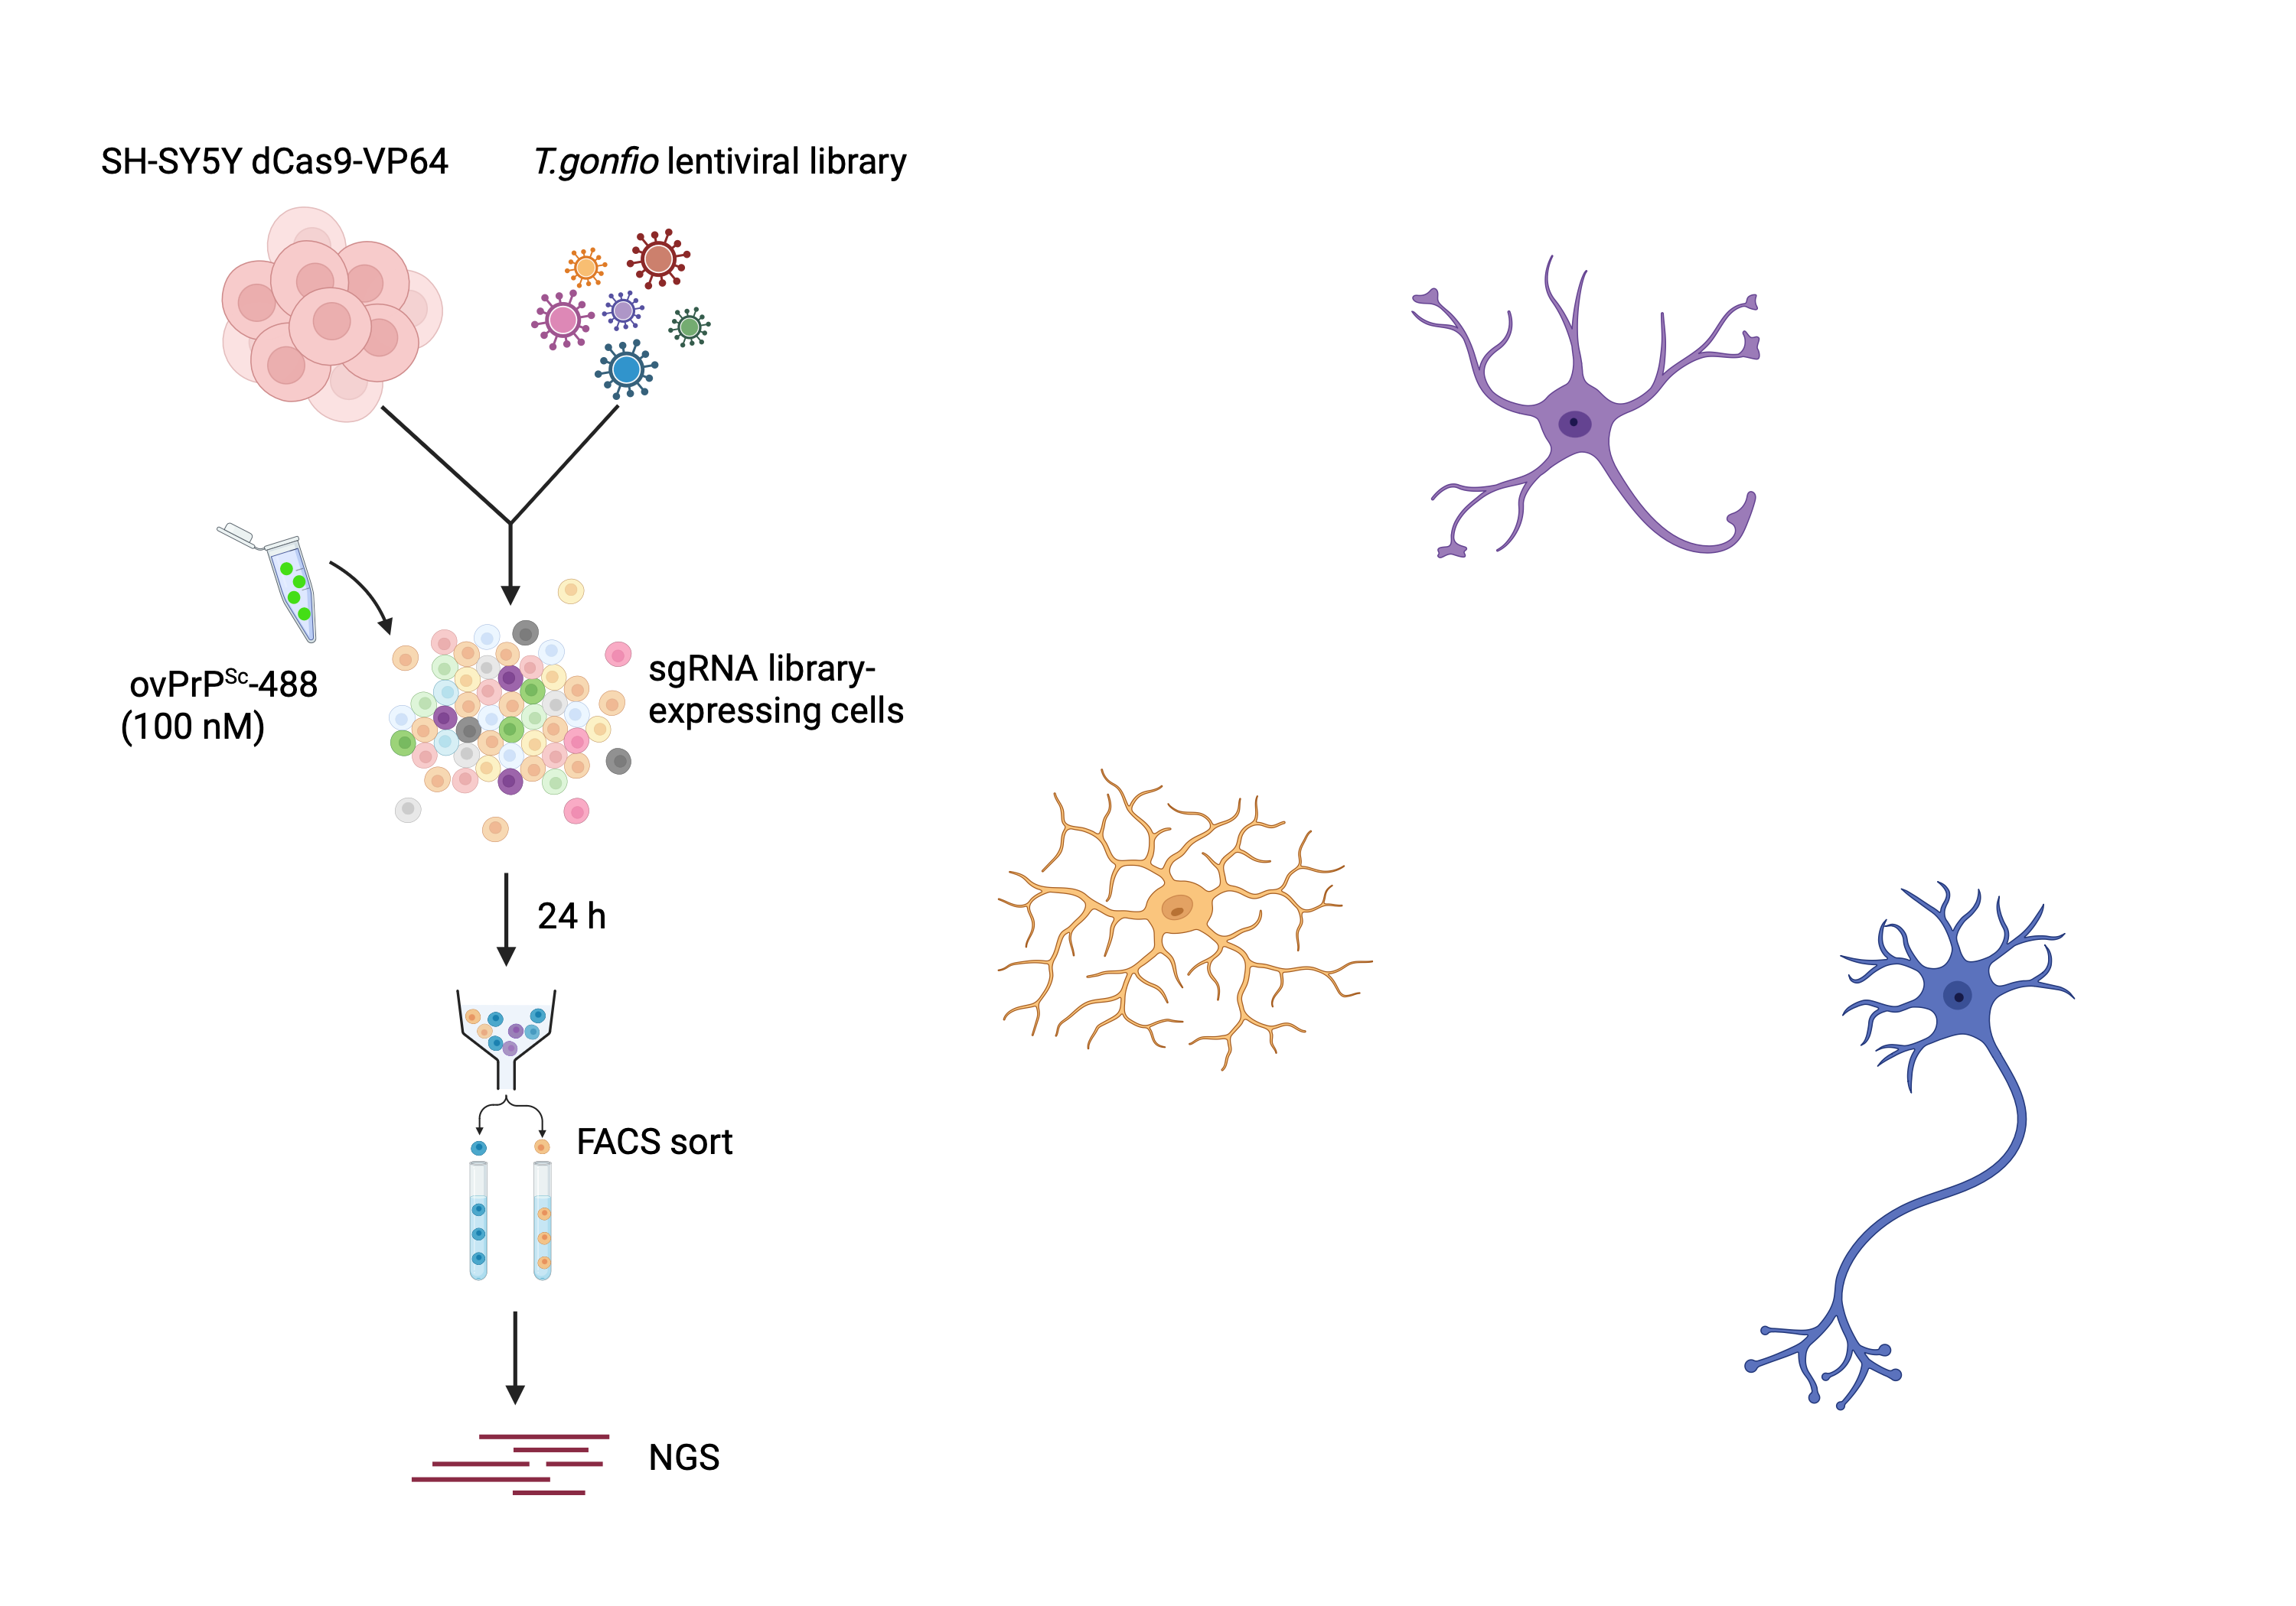
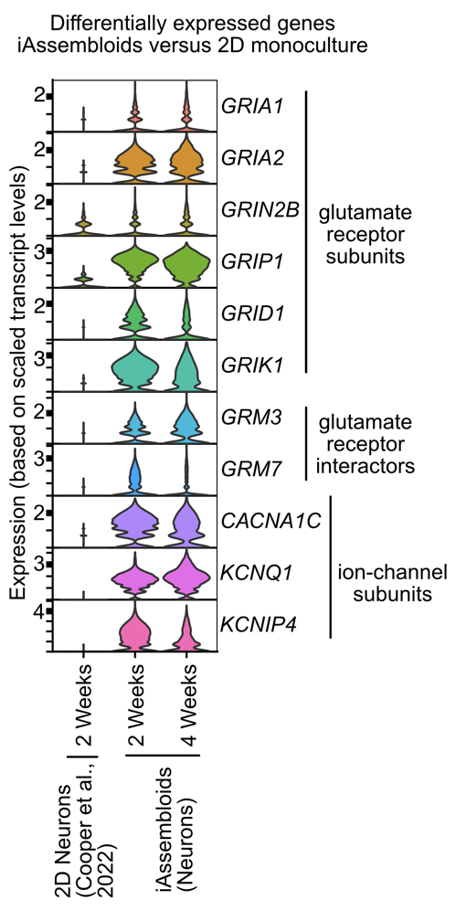
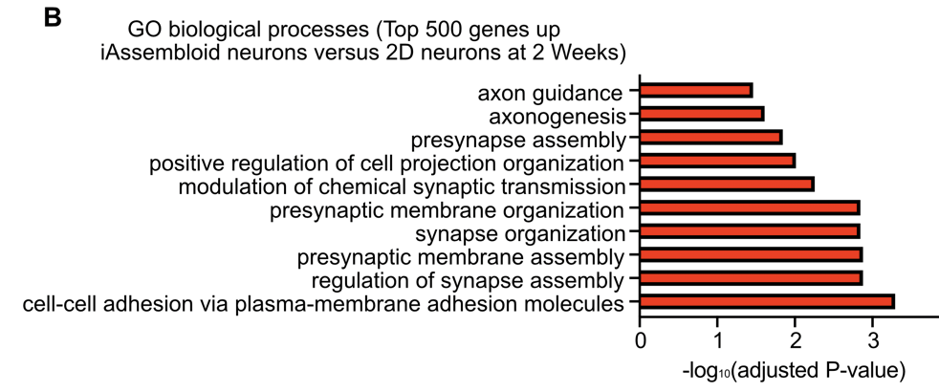
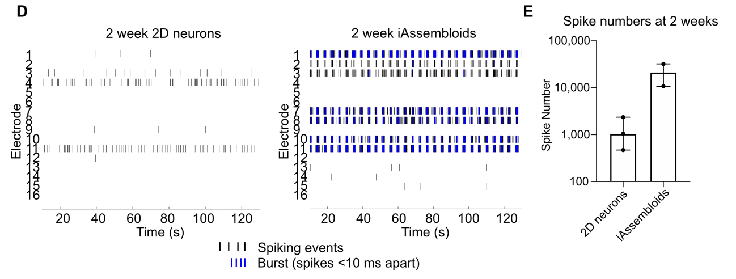
Neurons
Genes related to neuronal activity are more expressed in iAssembloids
Electrophysiological activity showed that iAssembloids have tenfold greater number of spikes

Slide 25
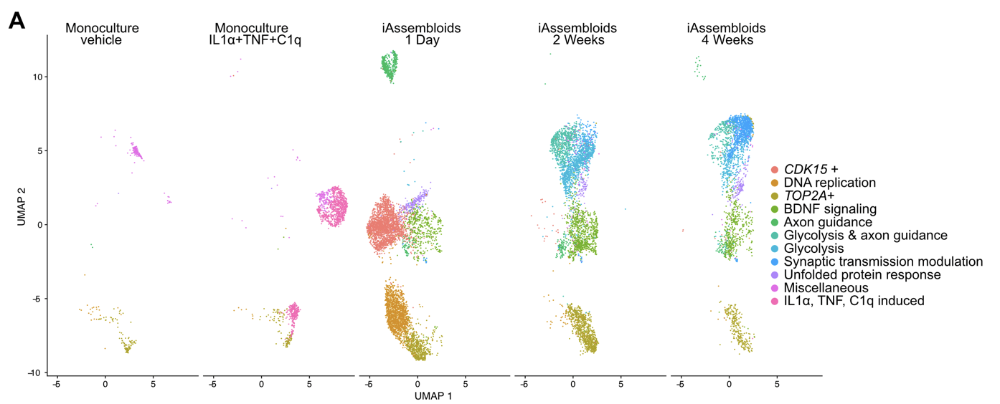
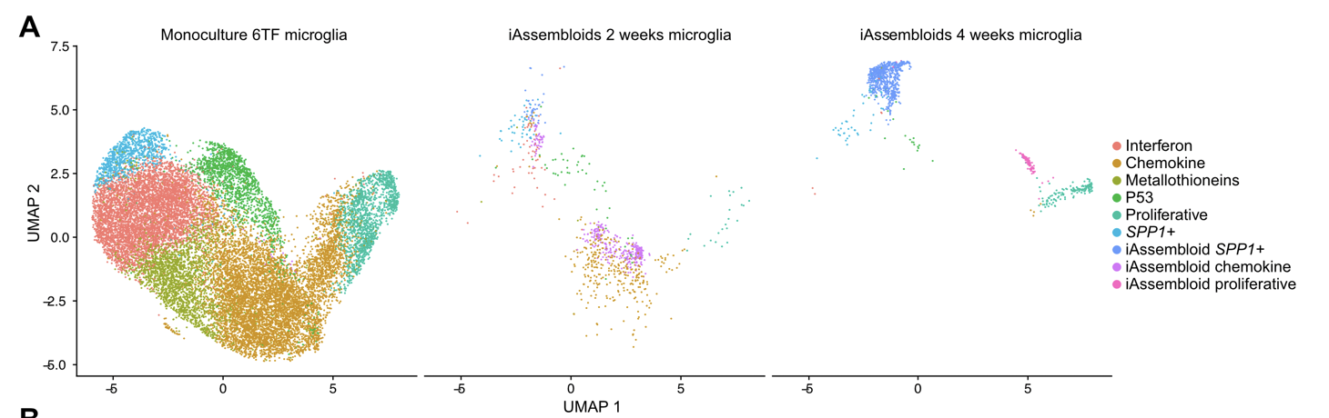
Astrocytes
Astrocytes develop transcriptional profiles that do not exist in 2D cultures.
Upregulated genes include BDNF signaling, axon guidance, synaptic transmission, glycolisis, UPR.
The transcriptional profile is associated with supporting neuronal function.
Microglia
Microglia initially clusters with monocultured microglia, but after 4 weeks forms new clusters expressing MHC-II markers as in nuerodegenerative diseases.

Slide 26
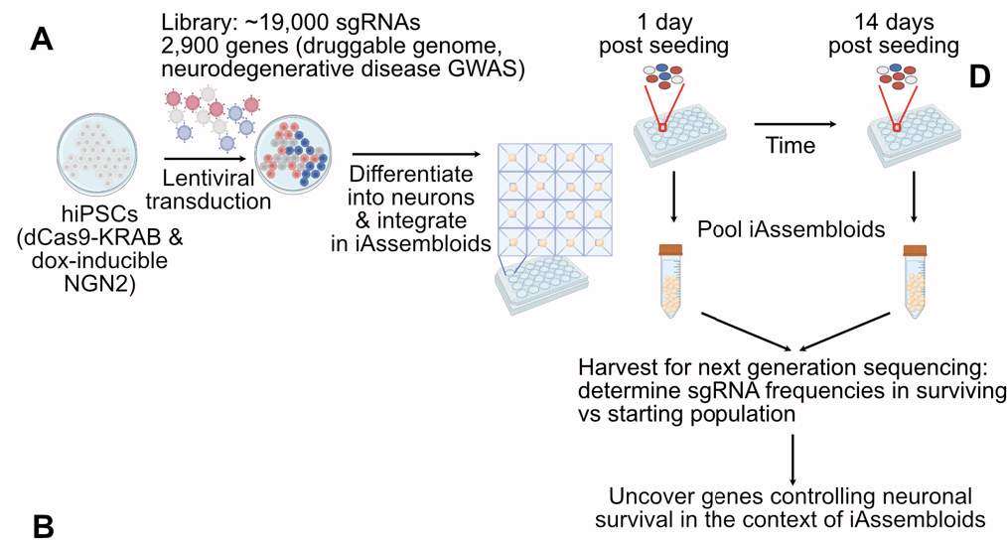
STEP III
CRISPRi screens
Screen #1: genes modulating neuronal survival in iAssembloids
3 timepoints:
- 1 day post seeding
- 14 days in culture
- 28 days in culture
Identification enriched and dropped out genes
iPSCs that will become neurons (NGN2⁺) stably express dCas9-KRAB
- kinases
- other druggable targets
- GWAS genes

Slide 27
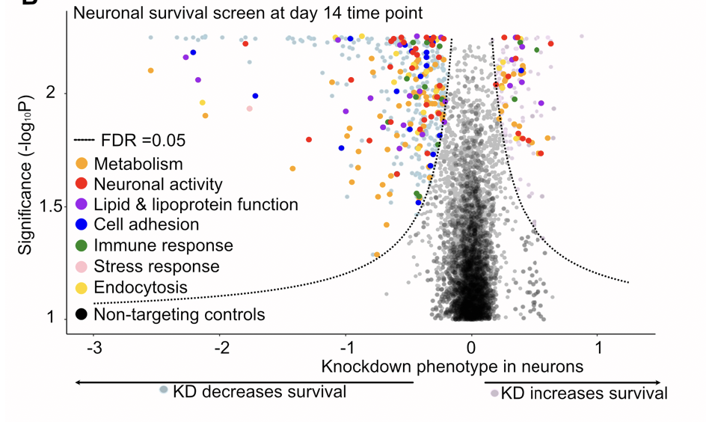
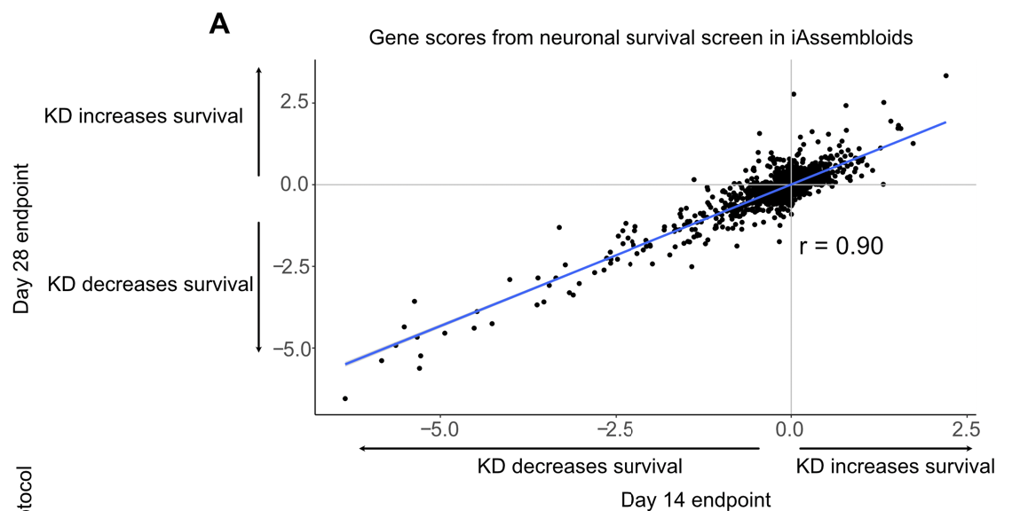
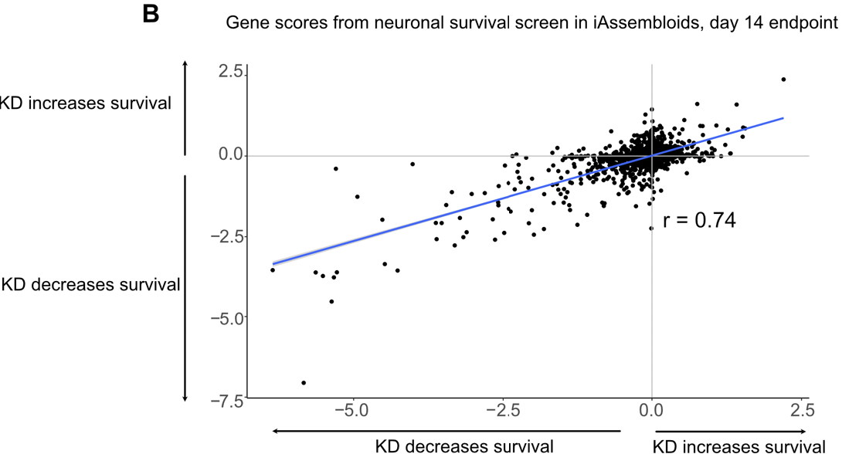
Replicate correlations were very good across two timepoints and in iAssembloids containing astrocytes generated with the two different protocols (with and without serum)
+ serum
- serum

Slide 28

Intersection with the same dataset obtained from 2D monocultures revealed that only some genes show up in both screens.
iAssembloids
2D
Shared essential genes
iAssembloids-exclusive genes
Secondary screen (68 genes)
Which genes affect neuronal survival in the presence of glia?
Which neuronal pathways are activated exclusively in iAssembloids?

Slide 29

Secondary screen - hit validation
CROP-seq on iAssembloids vs. neuronal monoculture to identify pathways that mediate the higher neuronal activity in iAssembloids
Downregulation of several genes including GSK3b, TTN, LMAN1 and players in the JNK-MAPK pathway drive up the expression of genes that are targets of boith NRF2 and STAT3

Slide 30


Downregulation of the same gene (GSK3B) in either iAssembloids or 2D monocultures leads to different regulation of NRF2 targets
NRF2 regulates genes involved in oxidative stress
GSK3B may influence NRF2 activity selectively in iAssembloids and therefore be responsible for the different activity levels observed in multicellular models.

Slide 31



Growth competition assay: NT cells and GSK3B-KD cells were mixed and ratio was evaluated at different timepoints
GSK3B-KD neurons grow better upon GSK3B KD only in 3D cultures, regardless of the presence of other cell types
What is the mechanism?
GSK3B KD promotes NRF2 translocation in the nucleus
GSK3B KD does not induce oxidative stress

Slide 32


ROS levels are 3-fold higher in 3D cultures than in 2D cultures.
GSK3B is more active in 3D cultures (less inhibitory phosphorylation) and blocks the NRF2-mediated anti-ROS response.
ROS mediate neuronal death by ferroptosis, as shown by the accumulation of peroxidated lipids.
GSK3B KD reduces the levels of toxic peroxidated lipids
GSK3B KD allows neurons to mount an efficient response against ROS, promoting survival

Slide 33


Where does the excessive oxidative stress in 3D cultures come from?
Neurons in 3D cultures are more active and therefore produce more ROS
Neuronal hyperexcitability increases ROS production and induces ferroptosis-mediated cell death in 3D monocultures.
In iAssembloids, glia acts as scavenger of ROS and reduces cell death.
Tetrodotoxin (TTX) blocks neuronal firing → decrease in peroxidated lipids and ROS levels

Slide 34


Slide 35



Screen #2: genes modulating neuronal survival in a disease-related context: APOE secretion
APOE is secreted by glial cells but affects neurons. Which genes specifically respond to APOE4 but not to APOE3?
Druggable genome (2000 genes)
Neurons expressing only APOE3
Screen output: enriched/dropped out genes
Two types of astrocytes:
-APOE3
-APOE4
APOE4-expressing astrocytes may sensitize neurons to death by altering one or more of these pathways.
The authors do not further investigate any of these hit genes.

Slide 36
Conclusions
Scalable 3D iAssembloids offer a novel platform to study non cell-autonomous phenotypes via CRISPR screens.
Cells in iAssembloids adopt more mature states and show different transcriptional states than 2D cultures.
GSK3B controls the response to ROS in hyperactive neurons. Its downregulation enables the NRF2-mediated response to ROS and promotes neuronal survival.
Glial cells counteract neuronal hyperexcitability and reduce ROS production.
CRISPRi screen on the non cell-autonomous effect of APOE isoforms on neurons identified insulin signaling and MAPK pathway as the probable effectors of APOE4 toxicity to neurons.

Slide 37

Presenter’s suggestion
Assembloids obtained from brain organoids (not spheroids!)
Mechanistic characterization of the role of pathogenic mutations (i.e. linked to autism) in the development of human interneurons

Slide 38


